Slide 1
Current Status of Daejeon Correlator for EAVN Se-Jin Oh and staff of Correlator team of KASI/NAOJ
8th East Asian VLBI Workshop, 8~10 July 2015, @Sapporo, Japan

Slide 2
Contents
KJCC correlation status
Problem, Solving Status
Recent Activities
Future Work

Slide 3
KJCC webpage
http://kjcc.kasi.re.kr

Slide 4
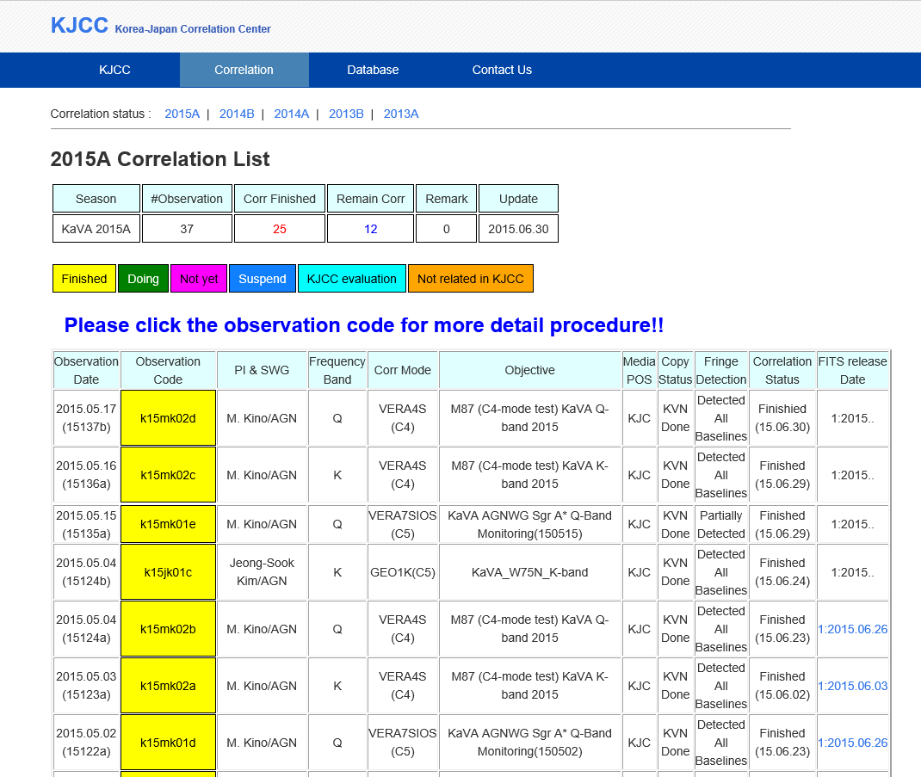
Correlation Status in KJCC web

Slide 5
Correlation Status
Season | Observation | Corr Finished | Remain Corr | FITS release
2015A | 41 | 25 | 16 | 25
2014B | 30(2 Geodesy) | 29 | 1 | 29
2014A | 56 (1 cancelled, 1 test) | 51 | 5 | 51
The correlation is now conducted normally.

Slide 6
Average Correlation Time
Media delivery time
KJCC to each VERA site, it took 4 or 5 days
Each VERA site to KJCC, it took almost 2 weeks or 16 days
Media staying time in KJCC
OCTADISK pack is staying in KJCC average 40days or longer. VERA AOC often requested to us more fast returning due to lack of media. Sometimes VERA used their own diskpack for KaVA obs.
Average correlation time
1 correlation per day is general. Sometimes 2 correlations are conducted.

Slide 7
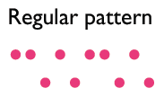
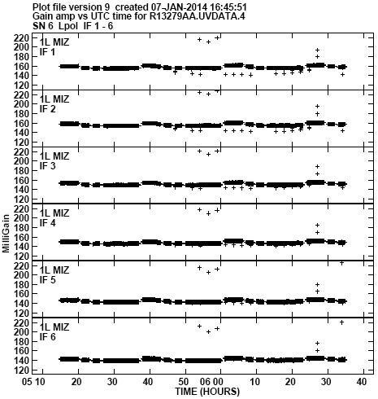
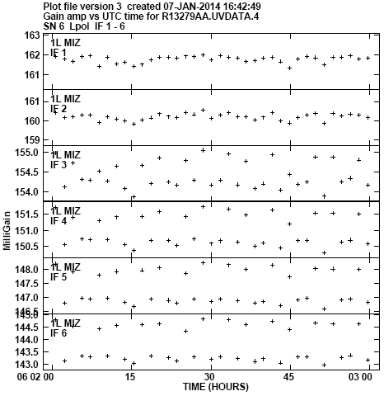
Problem, Solving Status
44GHz SgrA* (PI: Akiyama)
- No large jump & bridge pattern were shown
- we found two layer pattern which already known as Lee-san, Sawada-pattern
zoomed up
As reported last KaVA science workshop, two-layer(double-layer) pattern was remained in correlation result. After investigation in VCS seriously, we found the reason why double-layer occurs. That is memory reading point error in VCS data input part.
We solved this problem, the distributed FITS is fixed after 13th March, 2015.

Slide 8
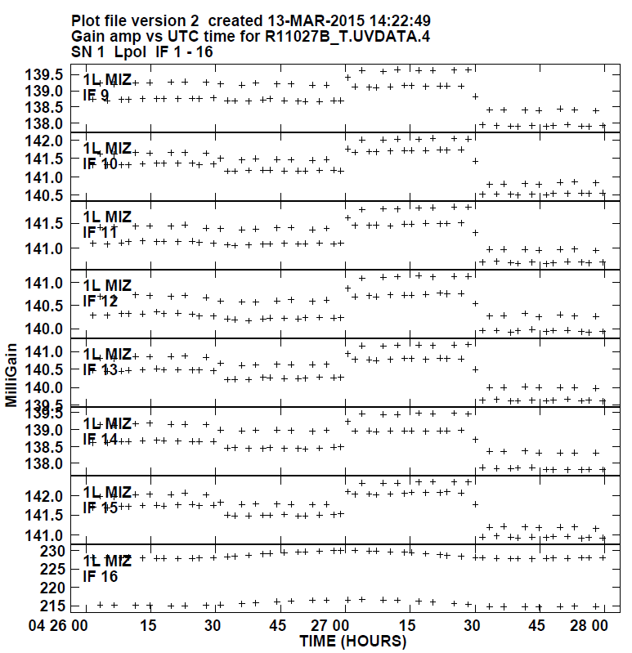
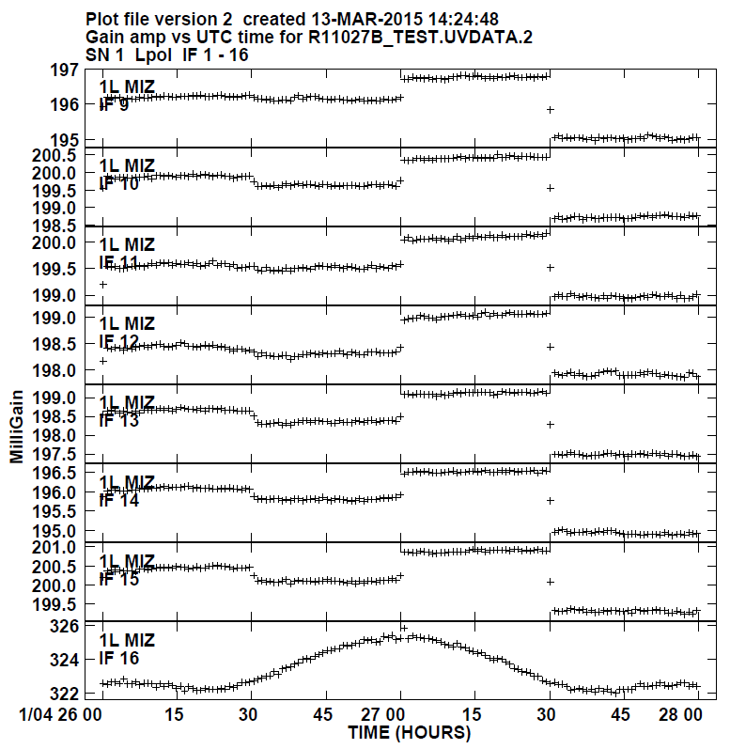
Test Result(Before, After)
Before
After

Slide 9
Recent Activities
C4 mode
2Gbps test correlation
EAVN correlation

Slide 10
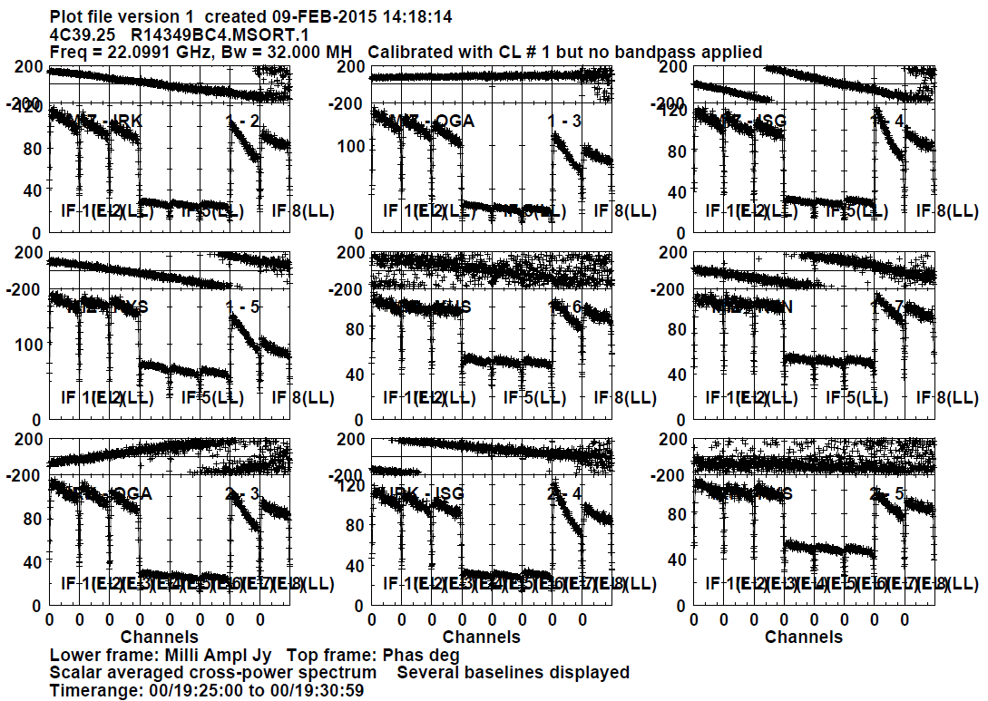
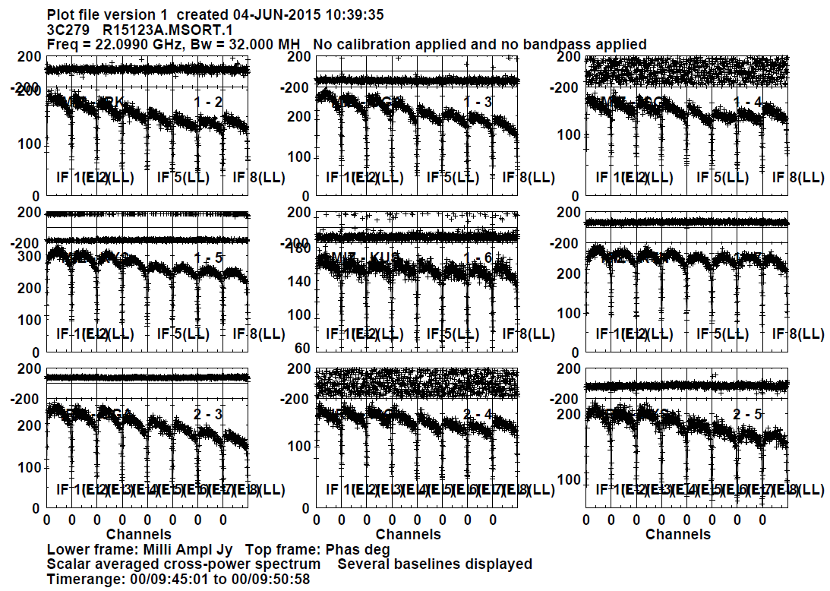
C4 mode
32MHz BW x 8 IFs
2014 vs. 2015
VERA Digital Filter setting is fixed
2014
2015

Slide 11
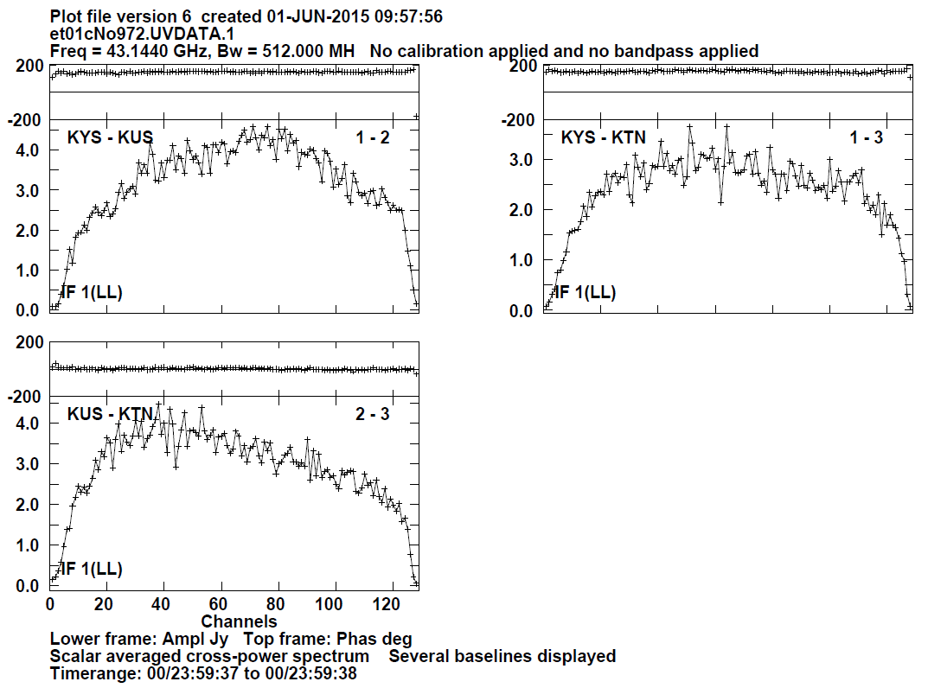
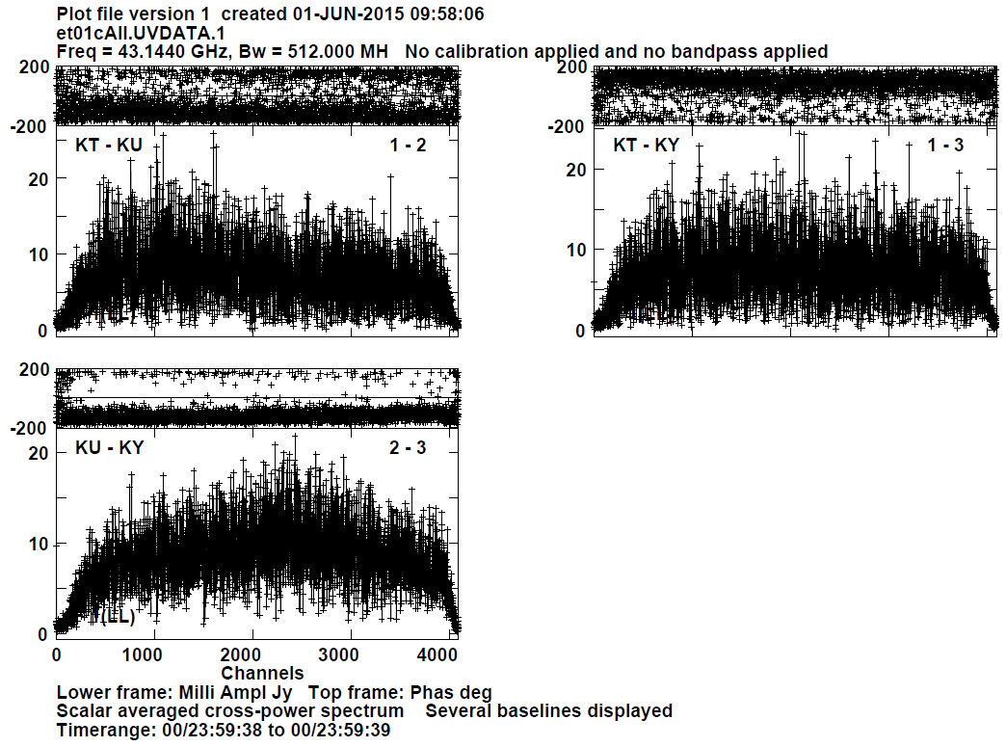
2Gbps test correlation
512MHz BW x 1 IF
KVN only test observation
2Gbps test observation will be regularly performed
KJCC
DiFX
3
2
1
2
1
128ch output
4096ch output
3

Slide 12
8th EAVN X-band correlation test(15. 6. 8.)
Obs date : 2015. 02. 12
Participant stations : KUS, TSU, YAM, SHA, KUN (5 stations)
Frequency : X, K-band
Obs band : 256MHz(16MHz x 16IF, 1Gbps)
Sources : 3C454.3, BLLac
Data collection : through FTP for 1min obs data.
Correlation : KJCC except YAM, due to cable error for standard clock.

Slide 13
Stations Position & Delay
 | X | Y | Z | Delay(μs)
KUS | -3287268.5430 | 4023450.1448 | 3687379.9675 | 1.600
TSU | -3957408.7520 | 3310229.3670 | 3737494.7890 | 4.865
SHA | (A) -2847698.0296 (B) -2831686.9930 | 4659872.5718 4675733.6390 | 3283958.5330 3275327.6410 | 39.18111
KUN | -1281152.7370 | 5640864.3810 | 2682653.4800 | 40.601
Frequency setup : channel allocations are different between KUS, TSU and SHA, KUN
KUS, TSU |  |  |  | SHA, KUN
Channel | Frequency | Sideband | Polarization | Channel | Frequency | Sideband | Polarization
CH01 | 8320 | L | RCP | CH09 | 8320 | L | RCP
CH02 | 8320 | U | RCP | CH01 | 8320 | U | RCP
CH03 | 8352 | L | RCP | CH10 | 8352 | L | RCP
CH04 | 8352 | U | RCP | CH02 | 8352 | U | RCP
CH05 | 8384 | L | RCP | CH11 | 8384 | L | RCP
CH06 | 8384 | U | RCP | CH03 | 8384 | U | RCP
CH07 | 8416 | L | RCP | CH12 | 8416 | L | RCP
CH08 | 8416 | U | RCP | CH04 | 8416 | U | RCP
CH09 | 8448 | L | RCP | CH13 | 8448 | L | RCP
CH10 | 8448 | U | RCP | CH05 | 8448 | U | RCP
CH11 | 8480 | L | RCP | CH14 | 8480 | L | RCP
CH12 | 8480 | U | RCP | CH06 | 8480 | U | RCP
CH13 | 8512 | L | RCP | CH15 | 8512 | L | RCP
CH14 | 8512 | U | RCP | CH07 | 8512 | U | RCP
CH15 | 8544 | L | RCP | CH16 | 8544 | L | RCP
CH16 | 8544 | U | RCP | CH08 | 8544 | U | RCP

Slide 14
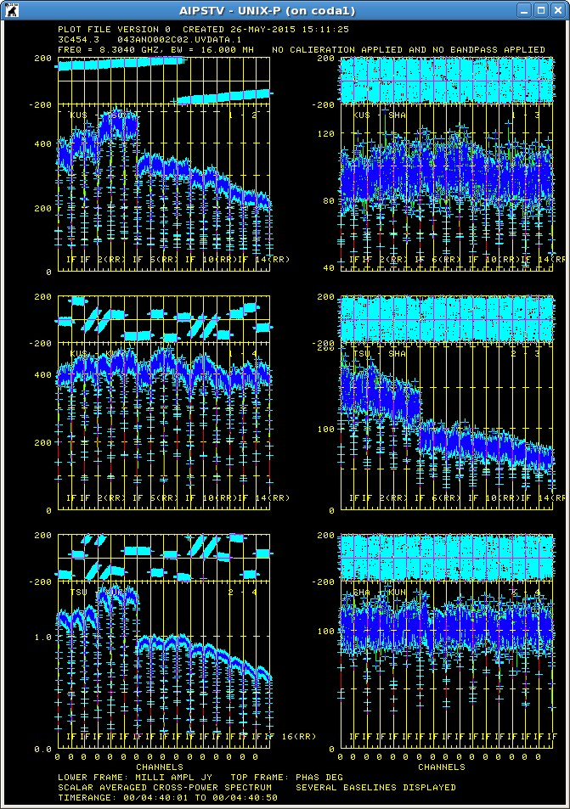
Correlation Result (A)
(15. 5. 27.) : 3C454.3 (04h40m ~ 04h41m)
By using old station positions(A),
fringe was not detected in Shanghai(Shesen) baseline.
KUS-TSU
KUS-SHA
KUS-KUN
TSU-SHA
TSU-KUN
SHA-KUN

Slide 15
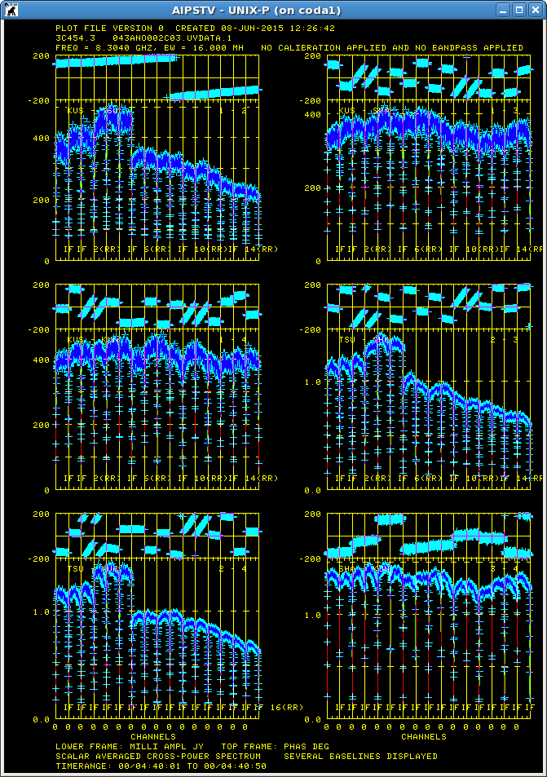
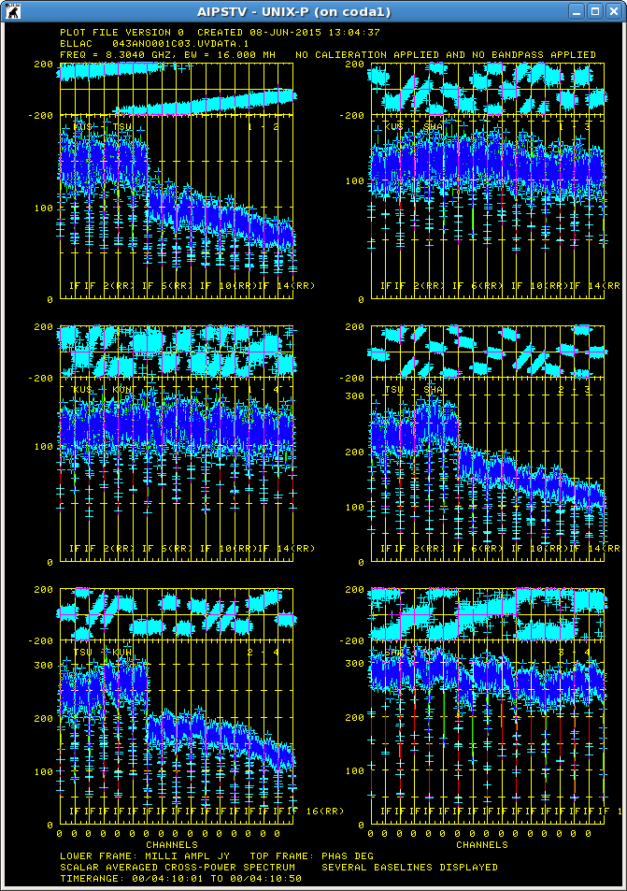
Correlation Result (B) by changing station position
3C454.3 (04h40m ~ 04h41m)
15.06.08
BL Lac (04h10m ~ 04h11m)
KUS-TSU
KUS-TSU
KUS-SHA
KUS-SHA
TSU-SHA
TSU-SHA
KUS-KUN
KUS-KUN
TSU-KUN
TSU-KUN
SHA-KUN
SHA-KUN

Slide 16
Consideration
In phase on SHA, KUN baselines ,
We considering that the IF channel allocation of CDAS is different from that of KVN and JVN DAS, therefore we should fully understand the IF channel allocation of each stations.
To do for EAVN observation
Fully understand each Backend system.
Adjust observation log for each station like clock, scans, weather information etc.

Slide 17
VDIF Data Transfer Software Development
Need data transfer method between HCDS(Huge Capacity Data Server) and RVDB(Raw VLBI Data Buffer).
Propose direct data transfer method from RVDB to HCDS
Proposed method performs data transfer by accessing data storage(OCTDISK, OCTADDB) of RVDB directly without pass through data input/output module(OCTAVIA)

Slide 18
Future Work
4/8Gbps test correlation
CODA/FITS generation SW modification for Fast switching
New Data Archive for Correlator output saving in 2016
Develop SW for making direct Correlator output to FITS file
Dual polarization correlation support

