Slide 1
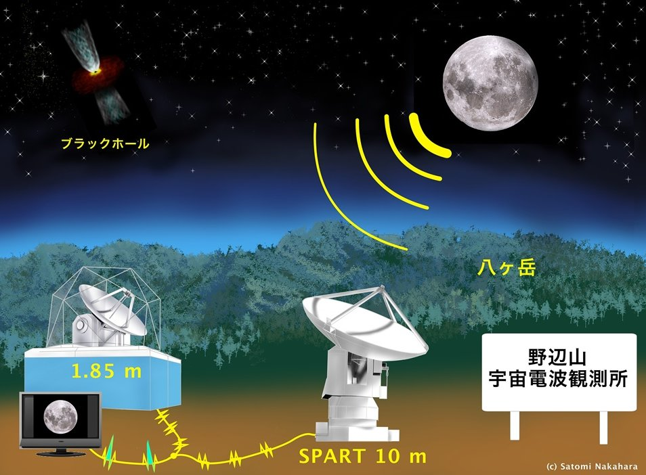
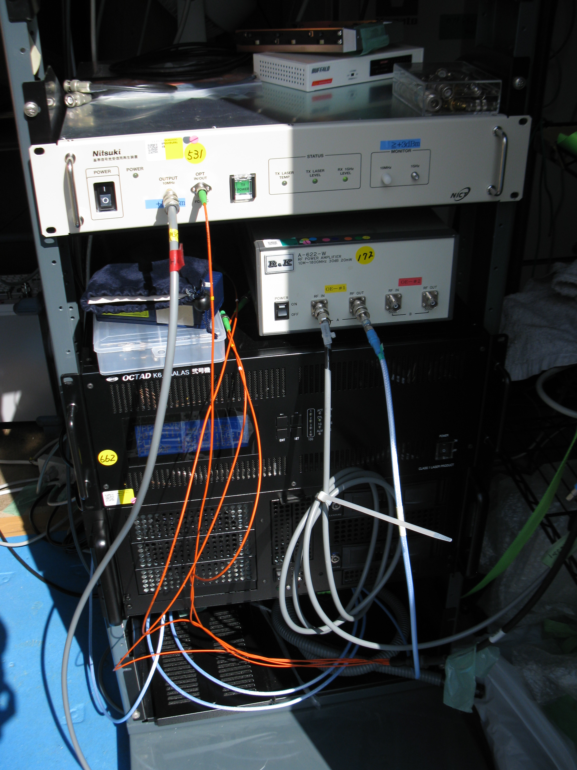
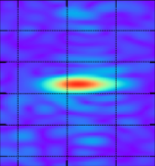
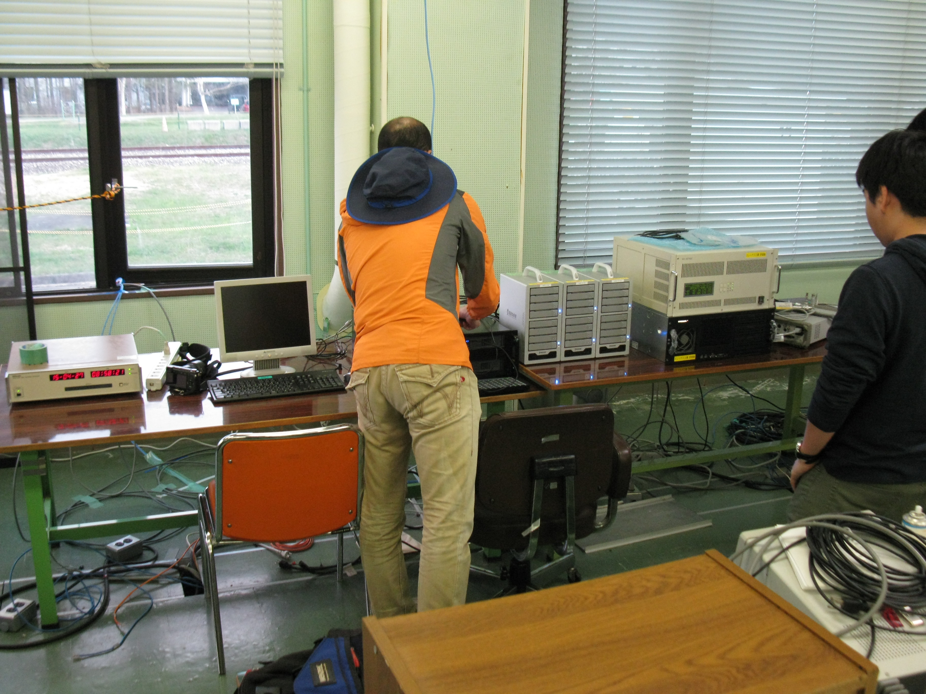
EAVN WS
2015/710@Hokkaido University
Millimeter Interferometer Collaboration Experiment 2015
(MICE2015)
Kenta FUJISAWA (Yamaguchi University)

Slide 2
Japanese short mm-VLBI activity
EHT
Honma et al.
Balloon
Doi et al.
Caravan
Miyoshi et al.
Universities
Institutes
230 GHz test VLBI in Japan
To obtain fringes and engineering experiment

Slide 3

All Japan mmVLBI team
NAOJ
Nobeyama Radio Observatory
Infrastructure for Observation
NAOJ
Mizusawa VLBI Observatory
Observation strategy, OCXO
Osaka Prefecture University
Telescopes, receiver and observing system
Ibaraki University
Equipment, arrangement
Yamaguchi University
Organization of this ‘team’
NICT Kashima
VLBI terminal, data reduction, 10MHz reference transfer
Kyoto University
Scientific advices
ISAS/JAXA
Observation strategy, OCXO

Slide 4
Outline of the experiment
Purpose
  Engineering experiment at the highest frequency so far
  Fringe detection (no image, no science, but engineering)
Experiment
  Date: April 27, 2015 (started in February!)
  Place: Nobeyama Radio Observatory
  Telescope: SPART 10m, 1.85m
    Owned/operated by Osaka Pref U for single dish observation
  Frequency: 230.000-231.024 GHz
  Source: Edge of the Moon
  VLBI terminal: NICT, NAOJ, ISAS/JAXA, Ibaraki, Yamaguchi
  Correlation: GICO3 software correlator by NICT
4

Slide 5
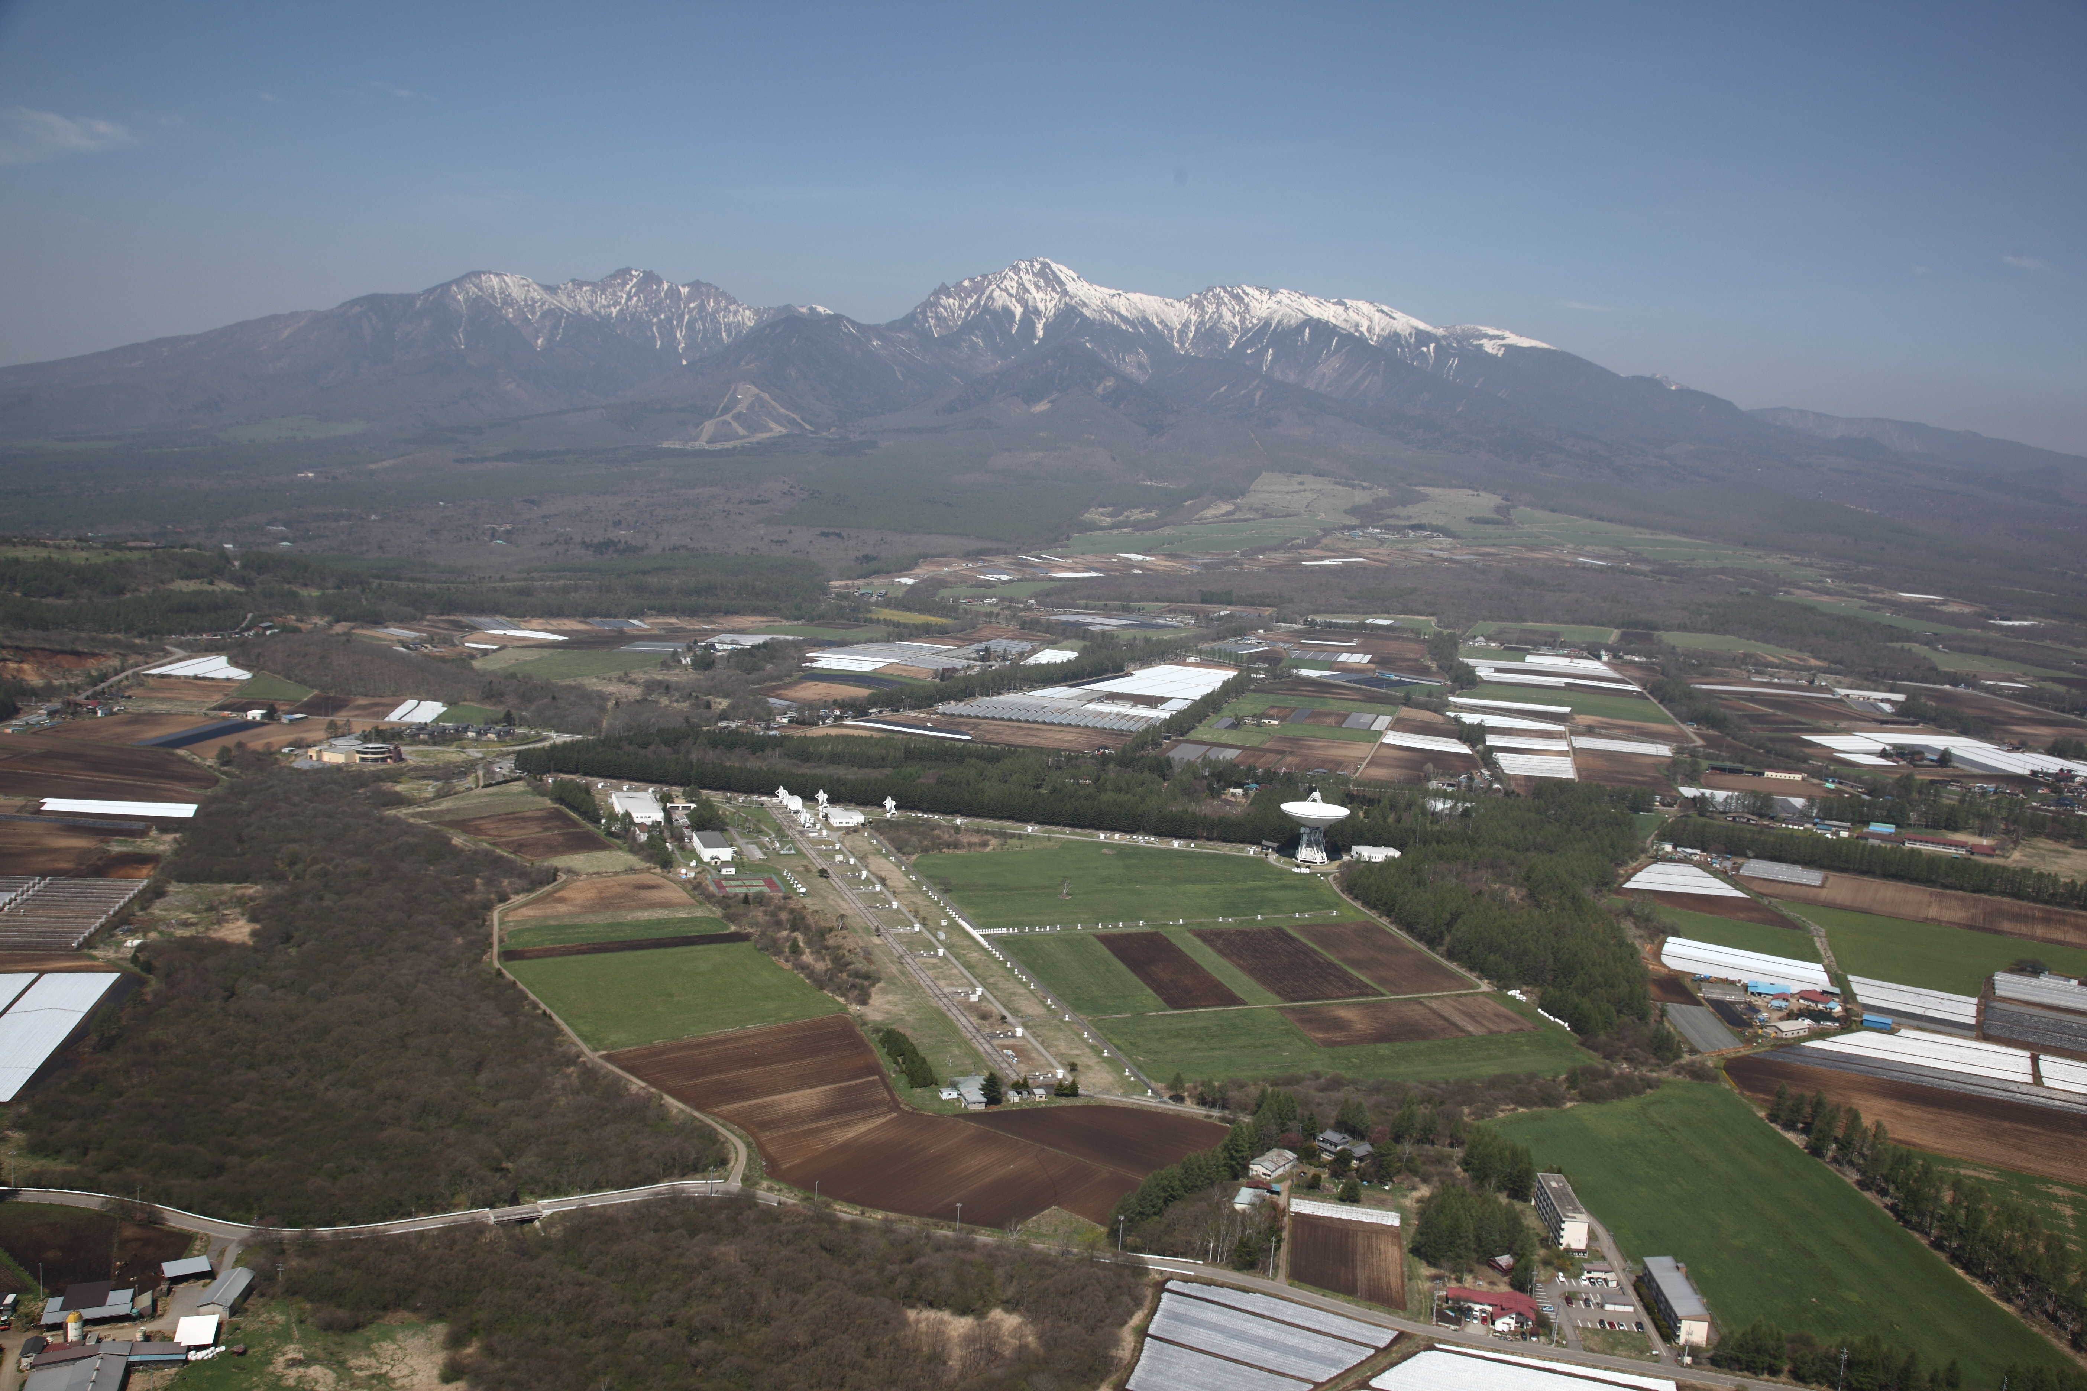
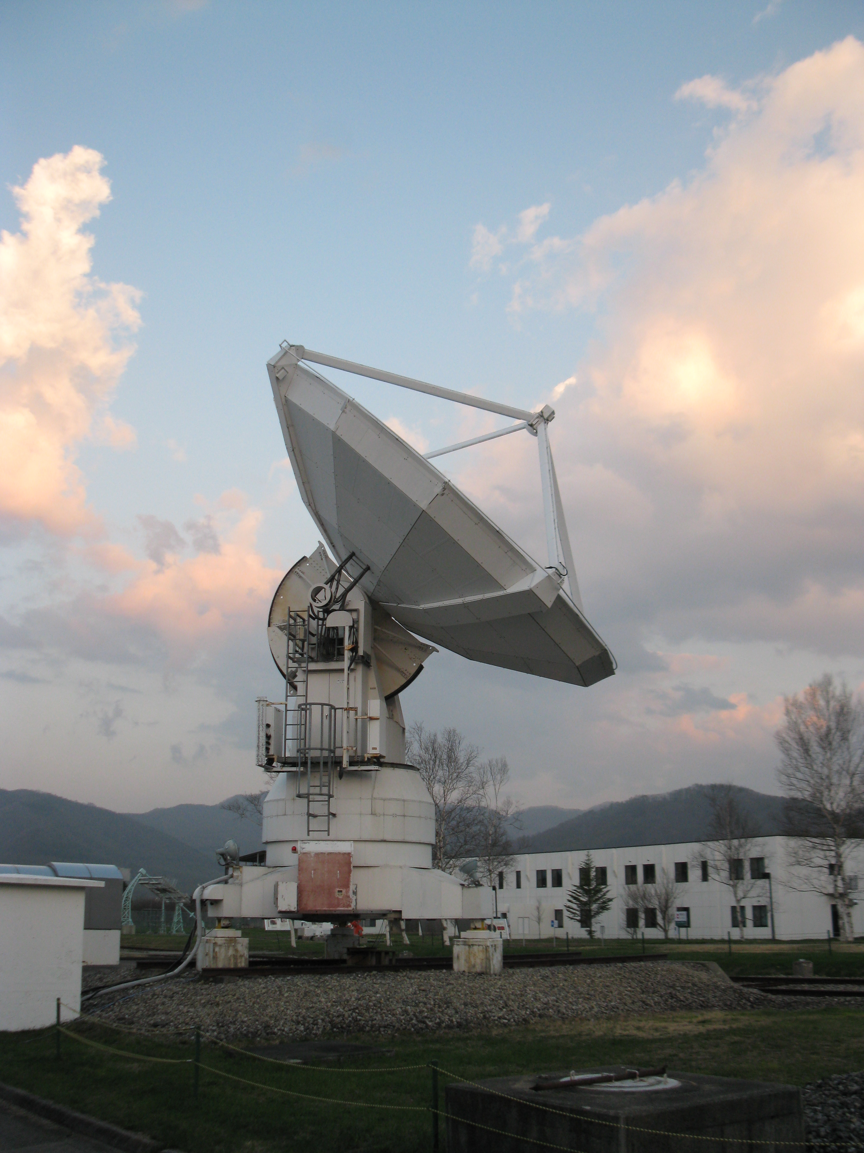
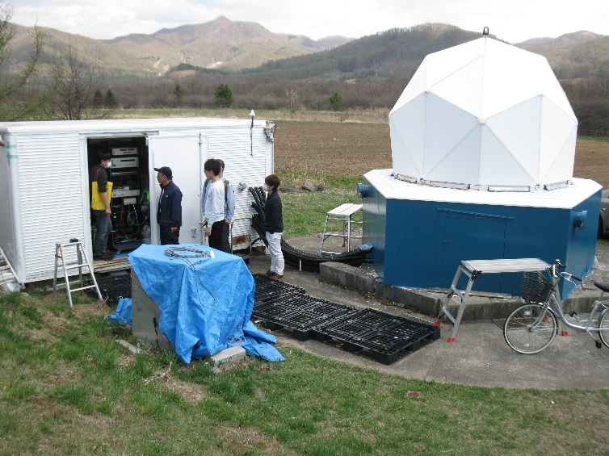
230 GHz VLBI at Nobeyama
Steady 230 GHz observation as single dishes
But
No VLBI back-ends
Need for building VLBI system temporary!
150 m
(VSBI)
Osaka Pref U
10m telescope (SPART)
(one of NMA)
Osaka Pref U
1.85m telescope
© 国立天文台

Slide 6
1.85m
Telescope
230GHz VLBI Experiment
(MICE2015) 2013/04/23 KF
10m SPART
Telescope
Source: the Moon
tracking: change the tracking position so that to maximize the correlated amplitude
Calibration
Tsys measurement
Frequency 230.000-231.024 GHz
no Doppler tracking
CO (2-1) line included so that to check the frequency setting
1.85m: USB, SPART: DSB
1.85m: circular pol, SPART: linear pol
Correlation: ftp just after the recording
Polarization
LHCP or RHCP
Station Position ?
λ/4 plate off
For Linear Pol
Cabin
Cabin
Frequency setting?
D/C
Spectrometer
Frequency setting?
D/C
Spectrometer
LO Sum
230.0 GHz
LO Sum
230.0 GHz
45m bldg
GPS
Confirmation of tracking
And 10 MHz reference
１．Ntp connection
２．ftp data transfer
Comparator
Power off the amplifier
Before pulling cable off
1 PPS
IF 0-2 GHz
0 dBm (?)
1PPS Gen
GPS
LAN
(Private)
10←5
5 MHz
Ref 10MHz
10 dBm
cntl
Ref TX
Ref 10MHz
10 dBm
10MHz distrib
H-maser
Sampler
GALAS
PC
DISK
Cabling
OCXO
1PPS
10MHz
+10dBm
1PPS Generator
ECHO AQ-3300
Build for this experiment
IF 0-1 GHz
0 dBm (?)
10MHz distributor
…
GPS
IB
1PPS
TIC
Agilent 53131A
Optical fiber
Lay on groung
240m （need protection）
TIC
LAN
(FIXED IP)
OCXO
Ref RX
1PPS
Cable path to inside of building
cntl
GPS受信機
(NTK )
Coaxial cable
2 lines of 30m on ground
（need protection）
Sampler
GALAS
PC
DISK
Installation of equipments
Power line
Coaxial cables
connectors
Power meter
Spectrum analyzer
tester
Observation Room
大阪府大／NRO
茨城大
山口大
NICT
NAOJ/ISAS

Slide 7
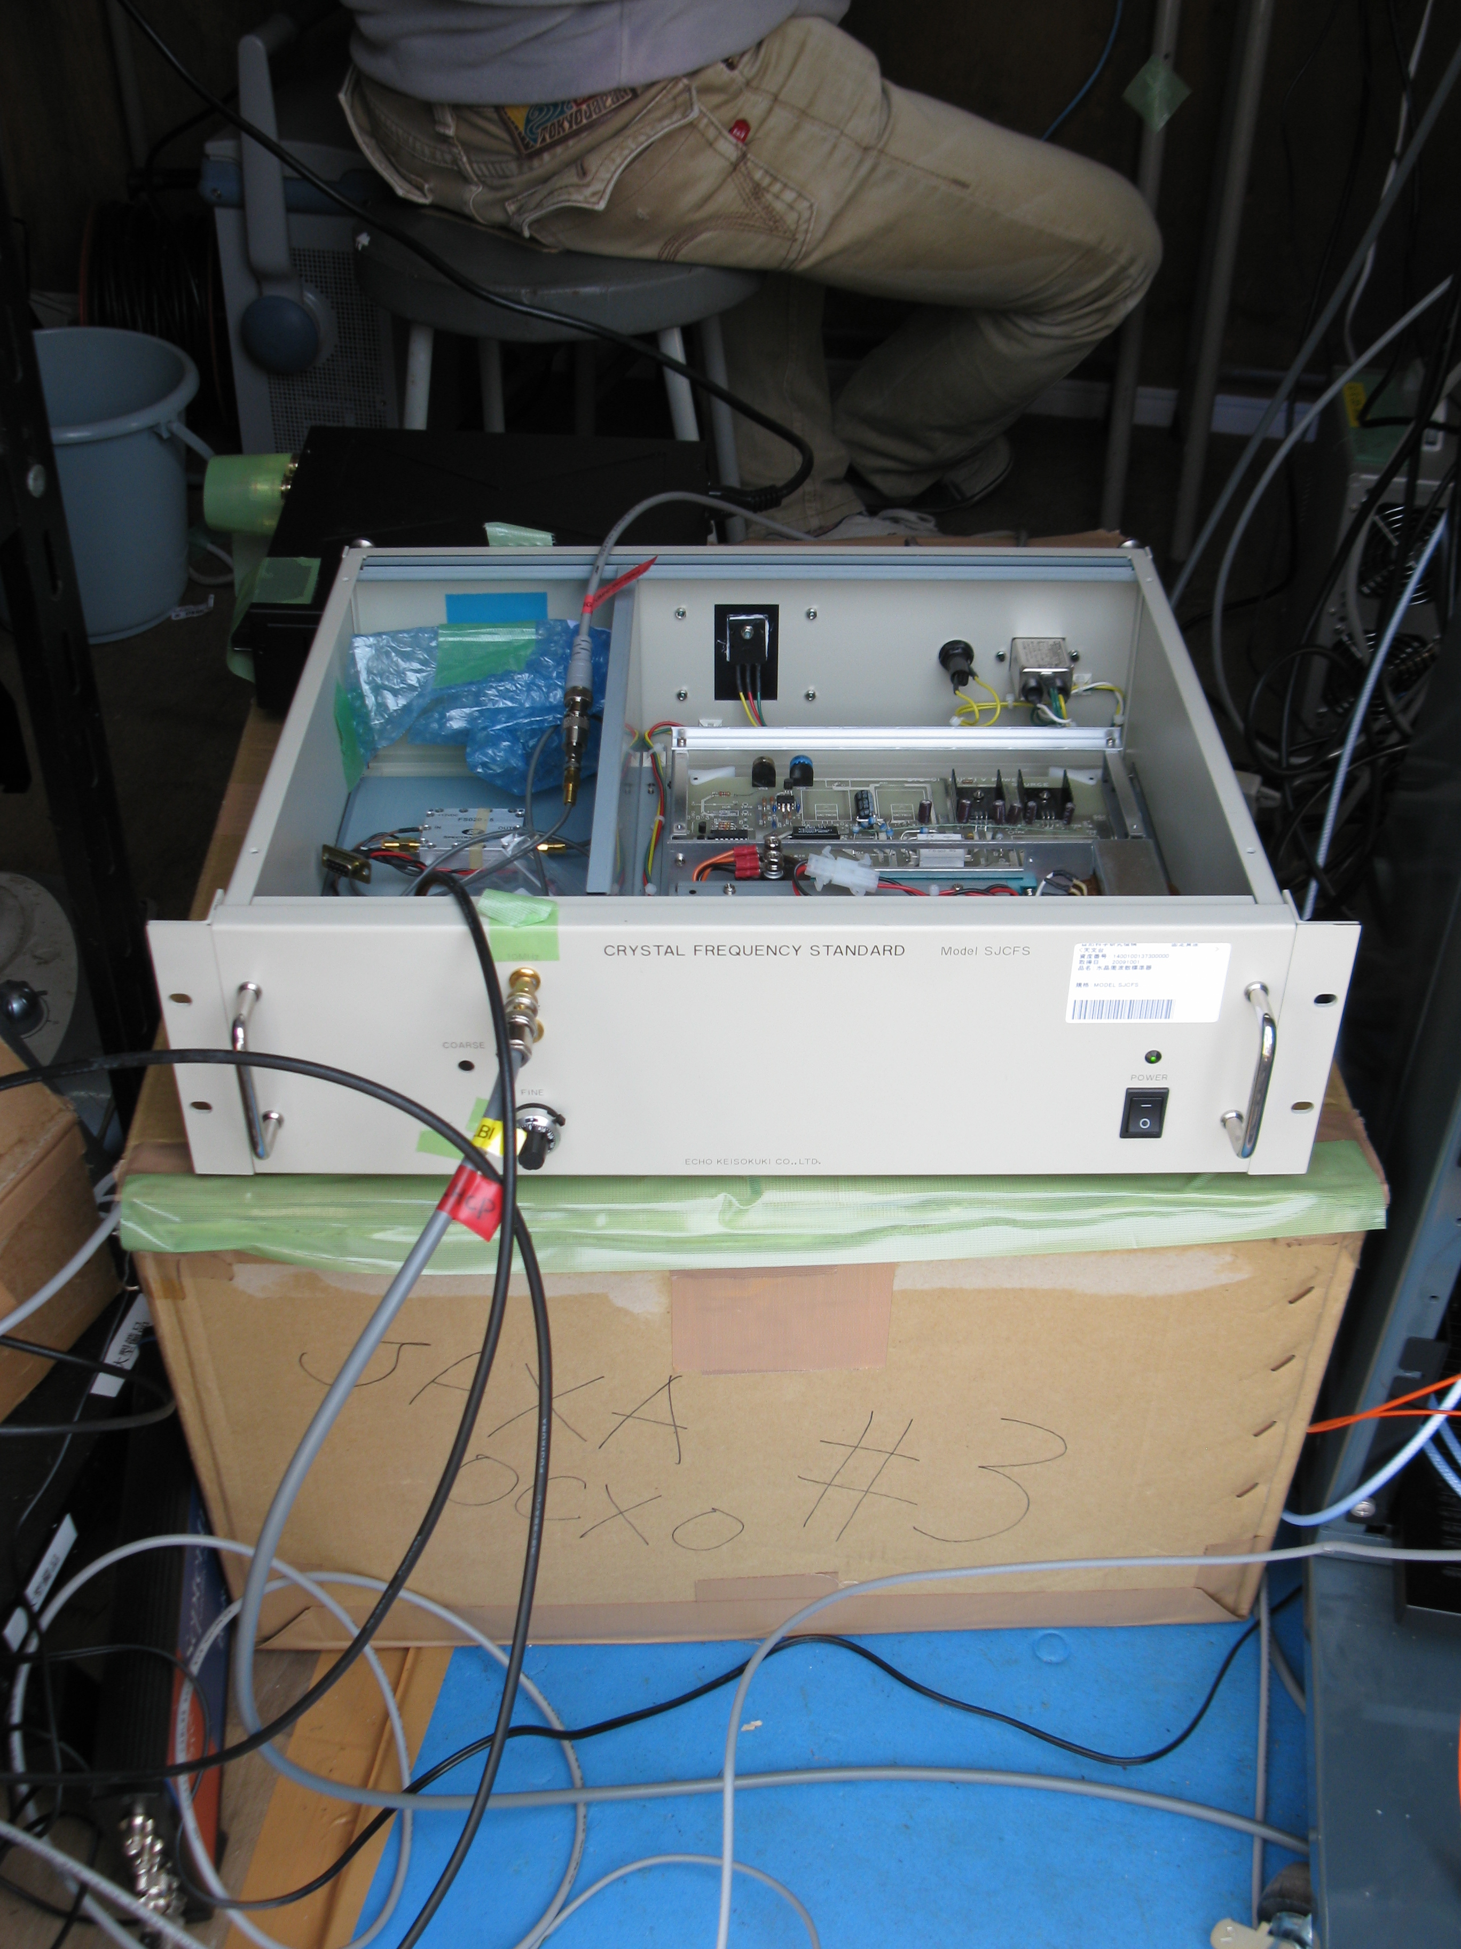
Three Reference Signal Modes
[Mode 1] Connected interferometer mode
  10 MHz transfer via optical fiber
[Mode 2] H-maser (SPART) --- OCXO (1.85m)
[Mode 3] OCXO (SPART) --- OCXO (1.85m)
OCXO
  Oven Controlled Xtal Oscillator
  Good Stability at 230 GHz for 10 seconds integration
  Cheap and compact (transportable)

Slide 8
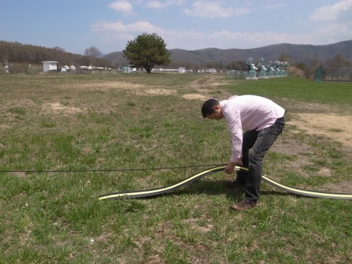
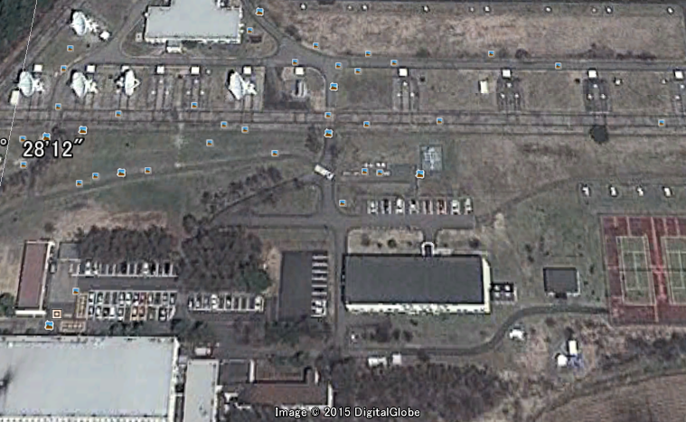
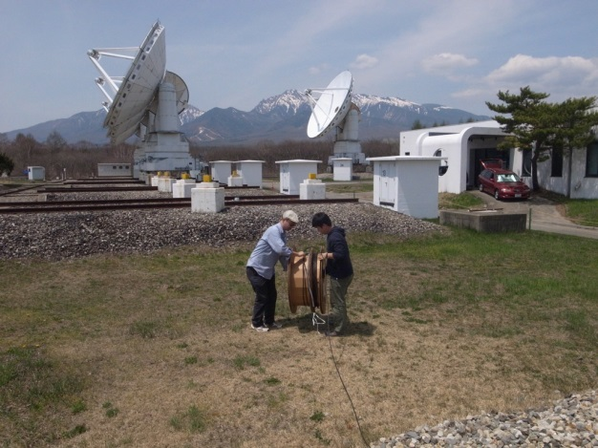

Optical fiber
protection
Fiber route for200m cable
Pulling out from a duct

Slide 9
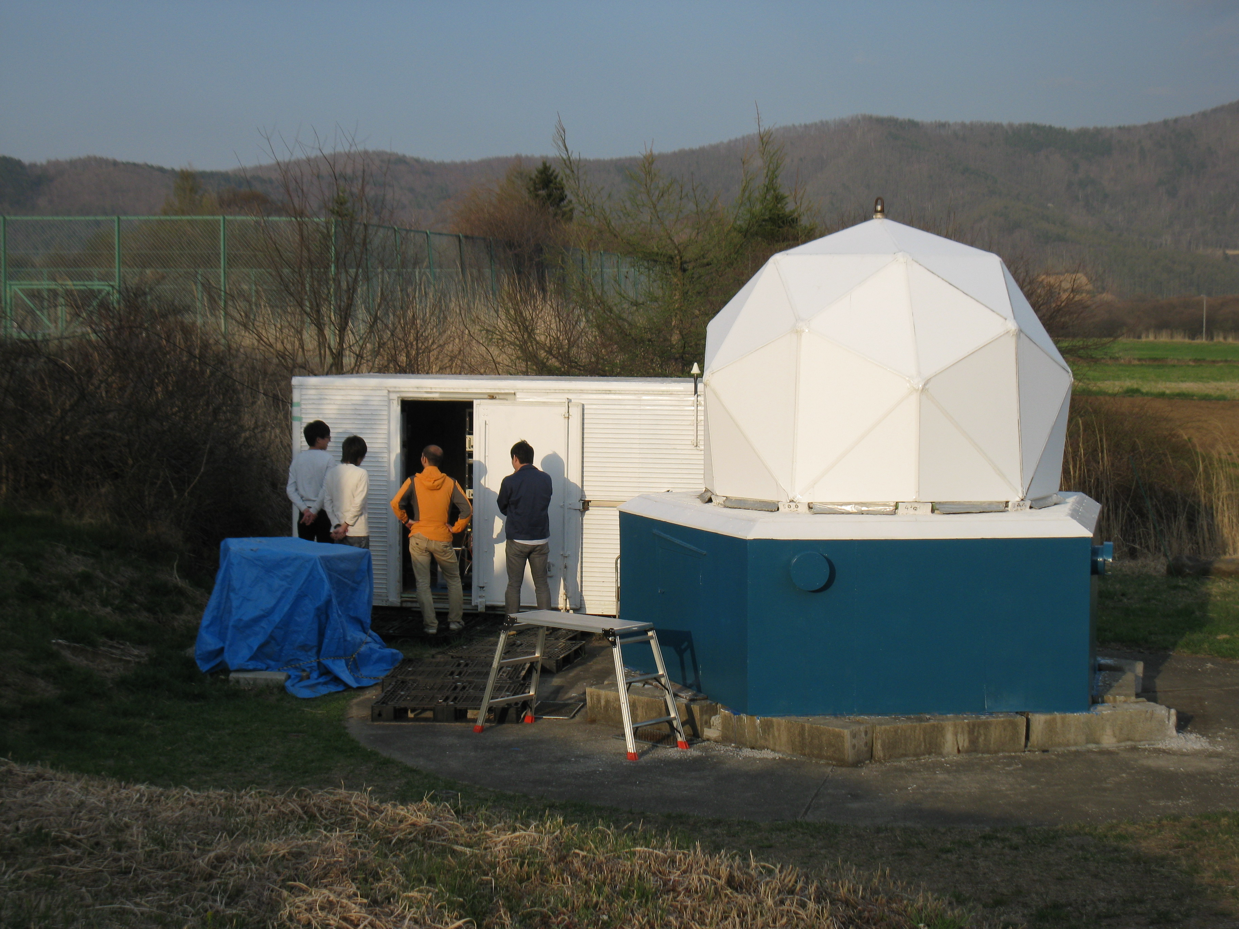

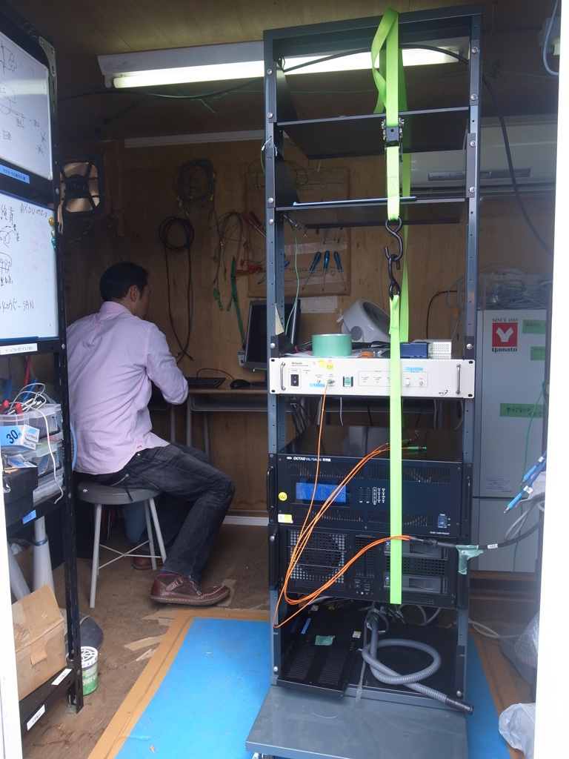
VLBI back-end for 1.85m
Optical fiber transceiver
Sampler (Galas by NICT)
K6 recording server
(RAID behind the server)

Slide 10
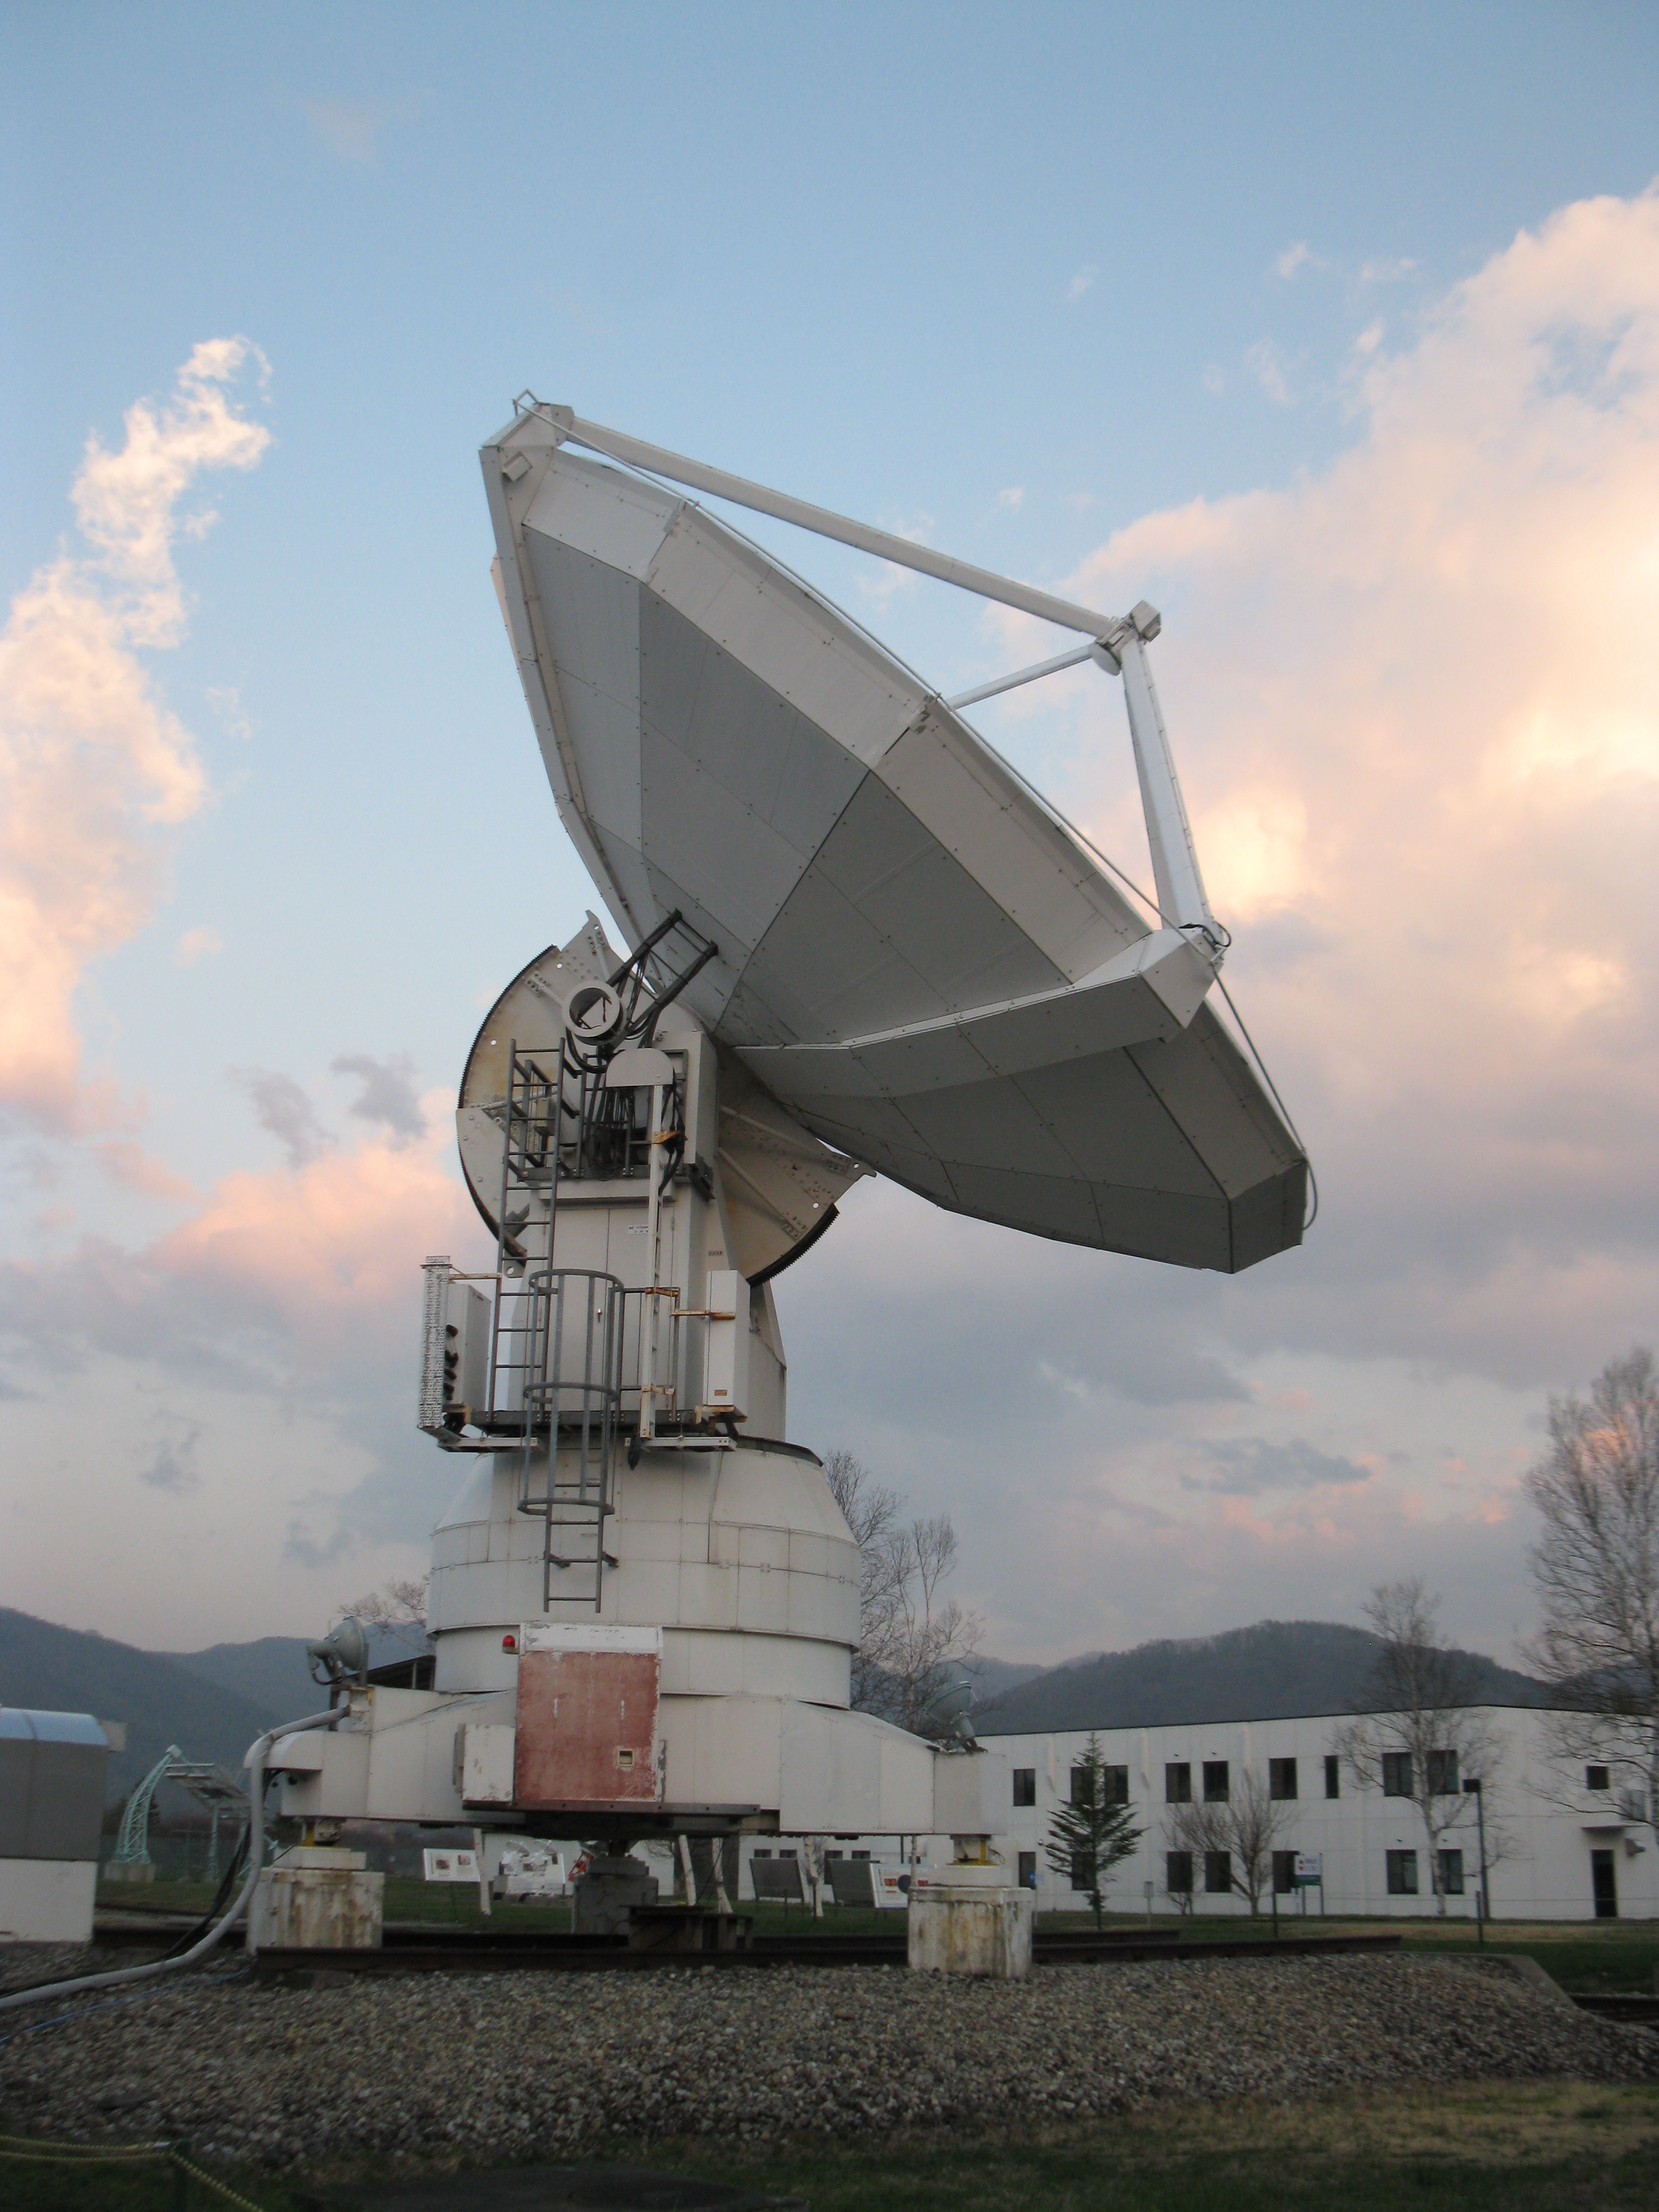
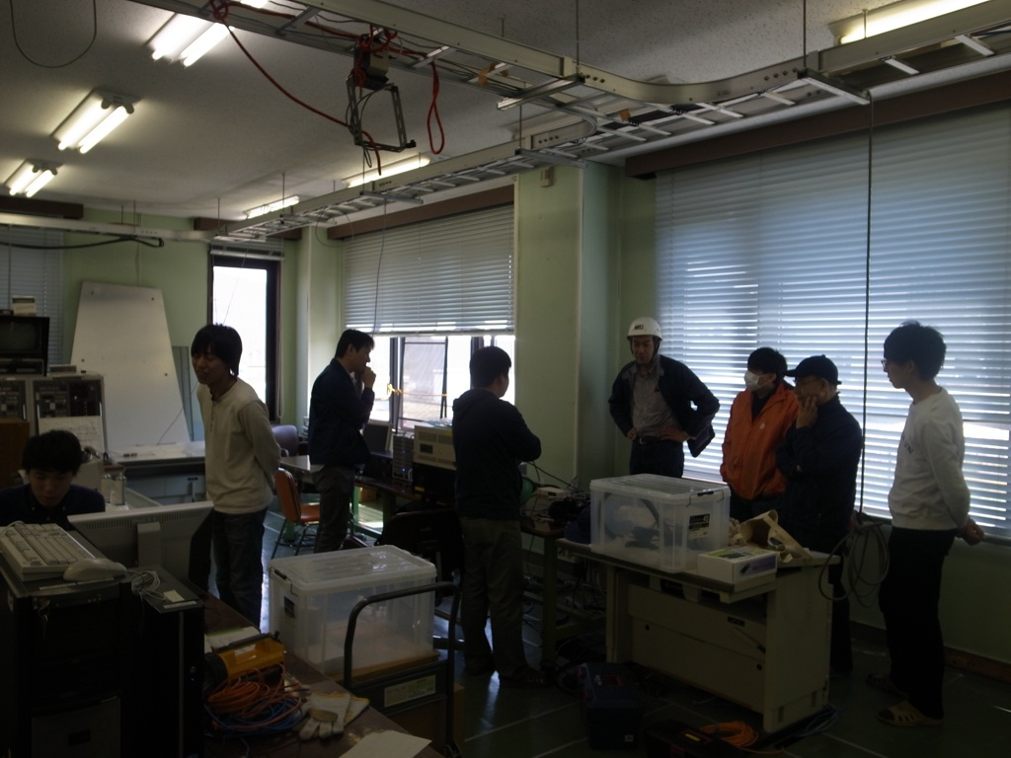
Back-end for SPART
Sampler (Galas)
K6 recording server

Slide 11
First 230 GHz fringe in Japan !
16k point / 100 Hz fringe search window

Slide 12
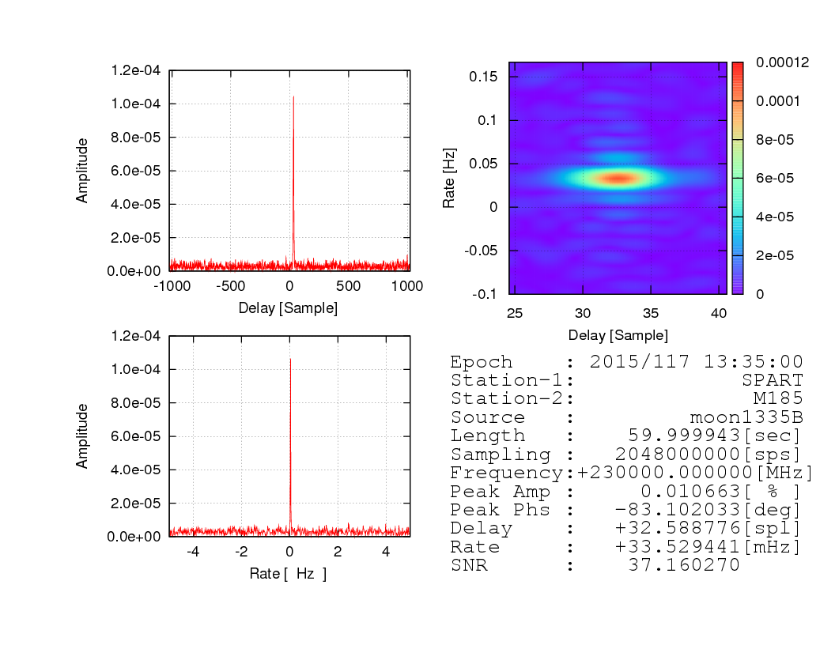
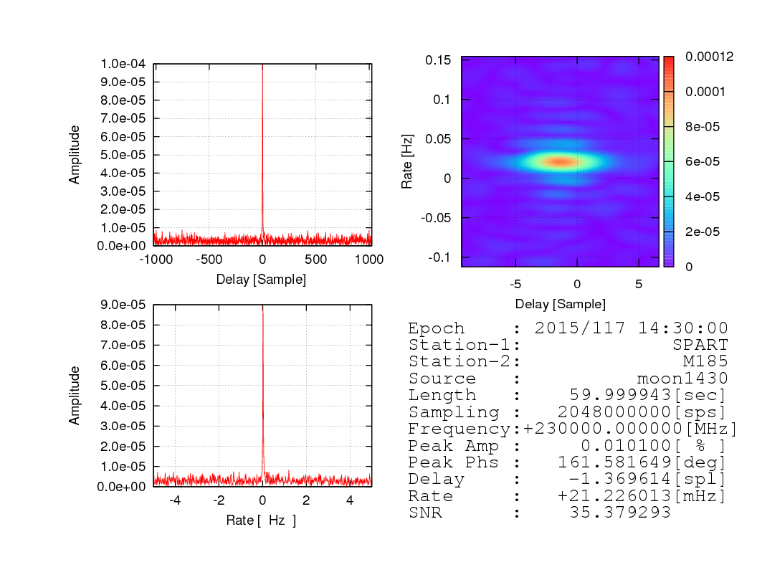
OCXOs showed good performance!
OCXO --- OCXO
H-maser --- OCXO

Slide 13
What’ Next ?
1. International Experiment
2. Scientific Observation
Chinese telescope??
Korean telescope??
SPART 10m
SMA ??
JCMT ??
NRO 45m
230 GHz Rx install??
EHT ??
KVN 86GHz??
NRO 45m
86 GHz

Slide 14
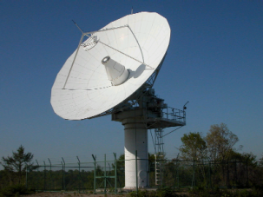

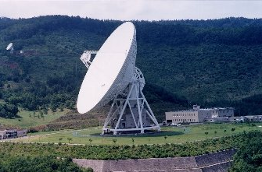
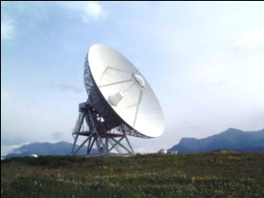
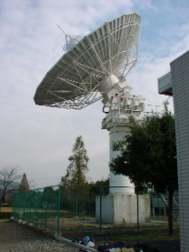
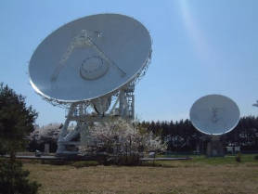
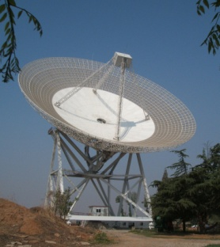
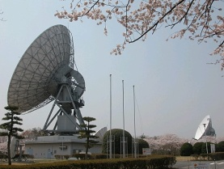
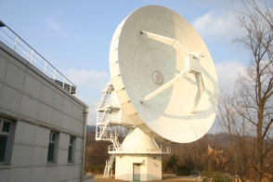
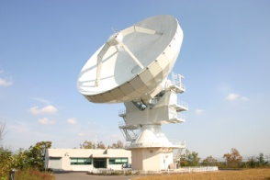
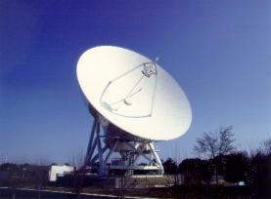
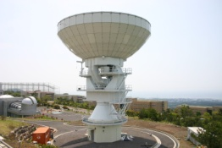
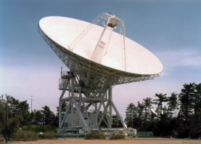
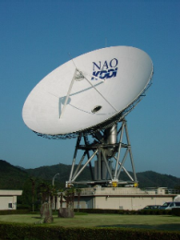
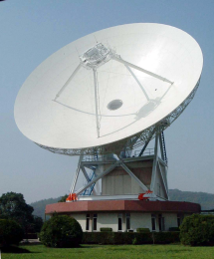
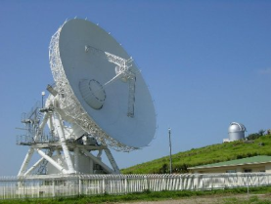
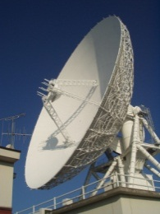
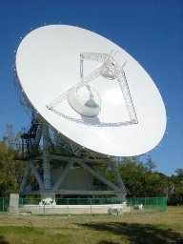
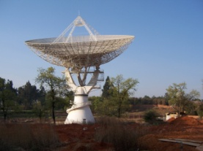
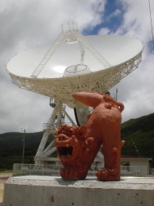
East-Asian VLBI Network
Short mm-VLBI in East Asia?
KVN-NRO45m＠86GHz?

