Slide 1

CVN software correlator development and its applications
Zheng Weimin*, Zhang Juan, Tong Li, Tong Fengxian, Liu Lei,
Chen Zhong, Shu Fengchun, Wang Guangli
Shanghai Astronomical Observatory,
Chinese Academy of Sciences
8th East Asia VLBI workshop, Sapporo, Japan
8 - 10 July, 2015

Slide 2
Outline
Development history
Applications in CE-3 mission
Development status
Future work
CVN software correlator

Slide 3
1. Development history
2003-2004
First CVN software correlator: Satellite Fringe searcher
Matlab
First domestic Geostationary, Elliptical Orbit Satellites VLBI correlation
2004-2007
FX type software correlator for Chinese Lunar Exploration Project (CE-1)
c language
ESA SMART-1, TC-1, TC-2 VLBI tracking experiment
Hardware correlator debugger & backup in CE-1 preparation stage
SMP parallelization

Slide 4
2007-2010
Primary CVN correlator in CE-1, CE-2 lunar projects
Near real time correlator, with satellite fringe search ability
Data latency < 2min
VLBI center latency ~ 6min
2011-2015
Primary correlator in CE-3, CE-5T1 projects
Real time correlation & satellite fringe search ability
MPI + OpenMP parallelization
Data latency < 10sec
VLBI center latency < 40sec
2011-2013
CVN Geodesy application of Crustal Movement Observation Network of China (CMONOC )

Slide 5
Outline
Development history
Applications in CE-3 mission
Development status
The future work
CVN software correlator

Slide 6
2. Applications in CE-3 mission
CE-3 Mission objective:
Complete the Chinese first soft-landing and roving exploration on the Moon (first probe to soft-land on the Moon since Luna 24 in 1976)
Demonstrate and develop key technologies for future missions.
Scientific objectives:
Lunar surface topography, lunar surface material composition and resource survey, lunar-based astronomical observation, etc.

Slide 7
New Requirements & techniques of CVN
High accuracy
Real time ability
Accurate Moon surface positioning
Combined orbit determination
( X band ΔDOR )
DOR – Differential of One-way Range
( e-VLBI + real time data process pipleline)
(Same Beam VLBI, SBI )
(2-way/ 3-way range + VLBI)

Slide 8
  Mission Requirements on VLBI
Earth-Moon transfer orbit phase & circumlunar phase
ΔDOR tracking group delay < 4ns (Actuality <0.5ns)
Orbit & angular determination and orbit prediction；
System data processing latency < 1minute (Actuality 15~40 seconds)
Lunar surface working phase
Lander & Rover tracking by SBI
Lander 3D position <1km (Actuality <100m )
Rover relative position of the lander <500m (Actuality ~1m )

Slide 9
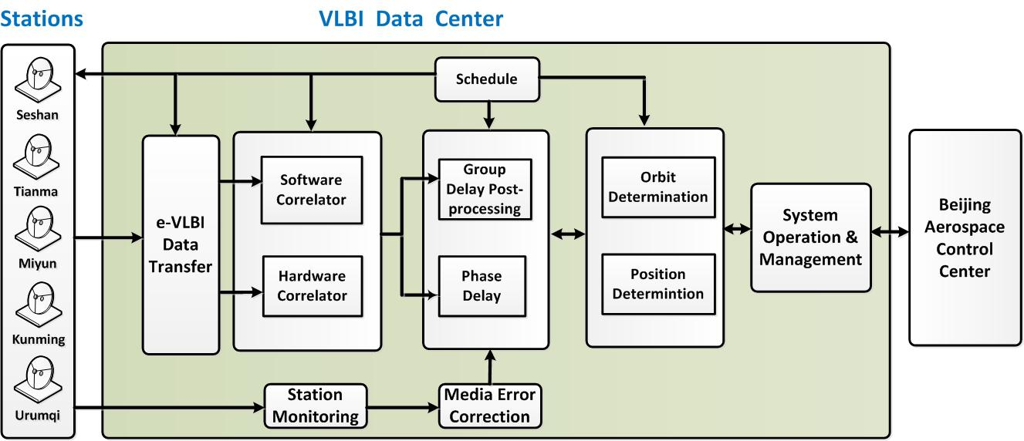
CVN data center real-time pipelines in CE-3

Slide 10
Block diagram software correlator
NFS: Network File System

Slide 11
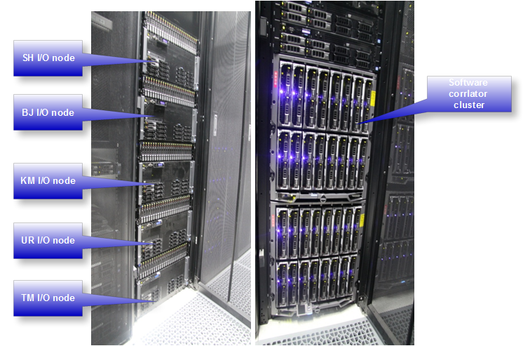
Computing platform
Standard Linux cluster
Five I/O nodes
- E7-4820*4/ 128GB/ 300GB+12TB
32 compute nodes*12 cores
fringe search + correlation
- E5-2640*2/ 32GB/ 300GB
2 manage nodes
- E5-2620*2/ 24GB/ 900GB+214GB
Management network
- 10G Ethernet
Compute network
- InfiniBand

Slide 12
Specifications of CE-3 software correlator
Processing Mode | Real-time & post-processing
Station number | 1~20
Real-time fast fringe search | 4 stations
IF number | 1,2,4,8,16
Frequency channel | 24~16384/IF
Integration period | 0.1~60 second
Maximum data speed (192 CPU cores) | About 1.9Gbps/station, totally 4 stations
Output format | CVN, FITS-IDI

Slide 13
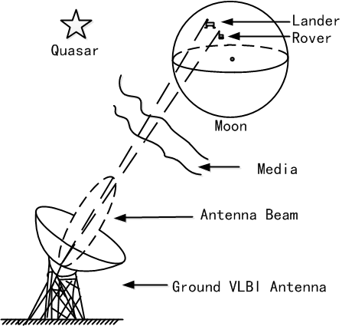
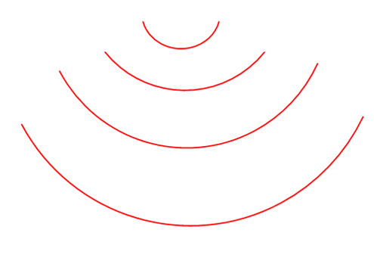

  Rover positioning by same-beam VLBI
Differenced VLBI group delay Real time mode
Same beam phase reference image
postprocess mode
Differenced VLBI phase delay, postprocess

Slide 14
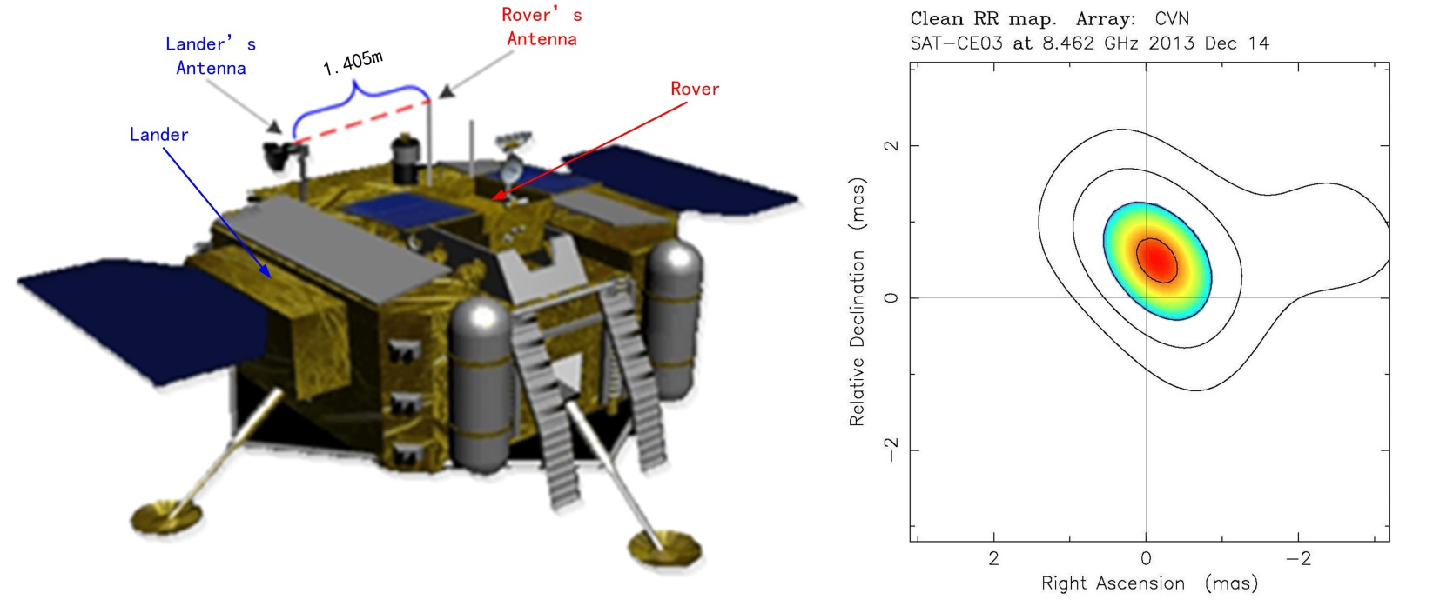
Null test by same beam phase reference image positioning
Null test error:
~ 0.6 m
Local coordinate | North | East | Down | Distance
Same-beam phase-referencing VLBI result | 1.197 | -0.005 | -0.759 | 1.417
True value | 1.016 | -0.605 | -0.759 | 1.405
Differences | 0.181 | 0.600 | 0.000 | 0.012

Slide 15
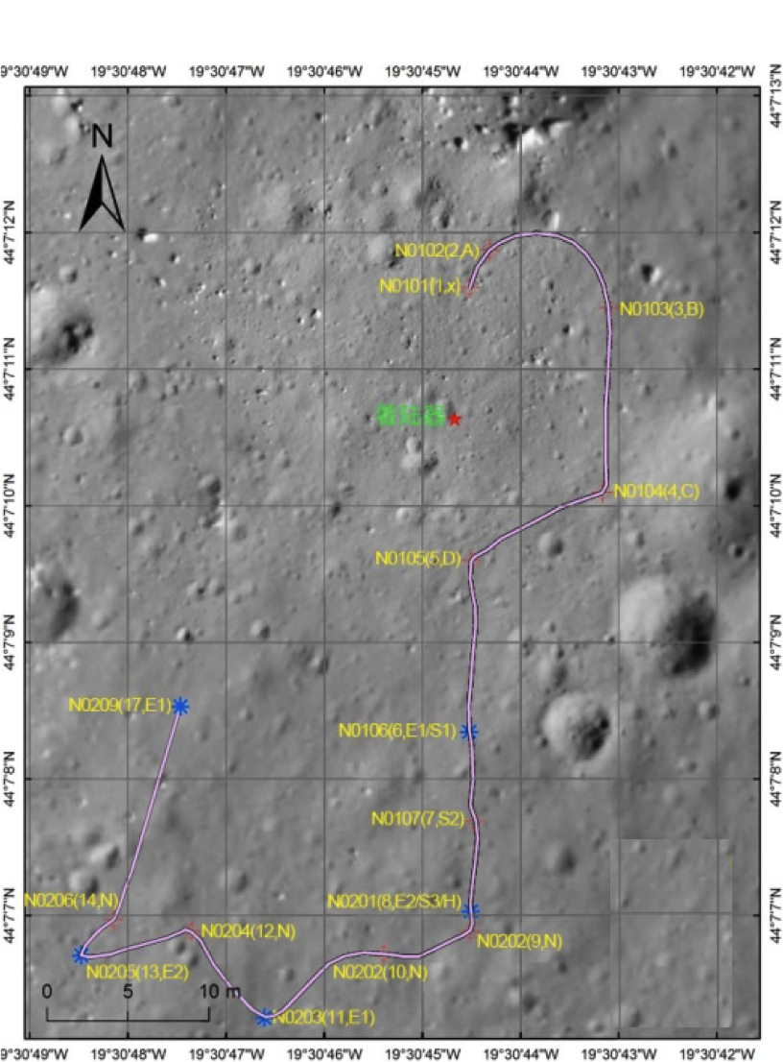
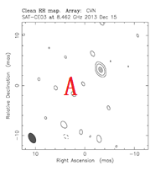
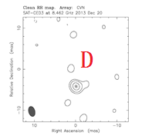
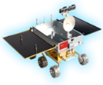

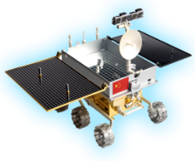
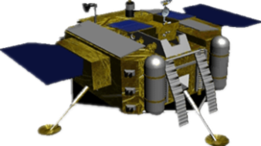
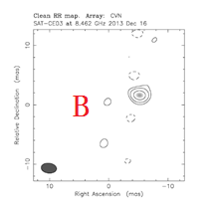
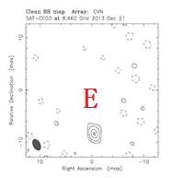
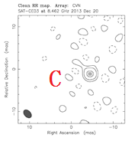
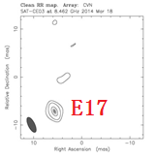
A
Rover
B
C
D
E17
E

Slide 16
Outline
Development history
Applications in CE-3 mission
Development status
The future work
CVN software correlator

Slide 17
3. Development status
Increase correlation speed by MPI+Pthreads
6 stations * 1.1Gbps/station->2.0Gbps/station
192 CPU cores
GPU acceleration: VGOS application
Geodesy application: Output format CVN--> Mk4,
Pulsar gate : Pulsar processing

Slide 18
CVN to Mark4 format transform test
Via DiFX software package
  cvn2difx: developed by our group
  difx2mark4: provided by DiFX
Direct convert
  cvn2mark4: under development
CVN visibility output
delay model
cvn2difx
DiFX SWIN format
.im file
Mark4 format
type-0 (root)
type-1 (corel)
type-3 (station)
difx2mark4
vex2difx
.vex
.input, .calc, .flag
CVN visibility output
delay model
Mark4 format
type-0 (root)
type-1 (corel)
type-3 (station)
cvn2mark4
.vex

Slide 19
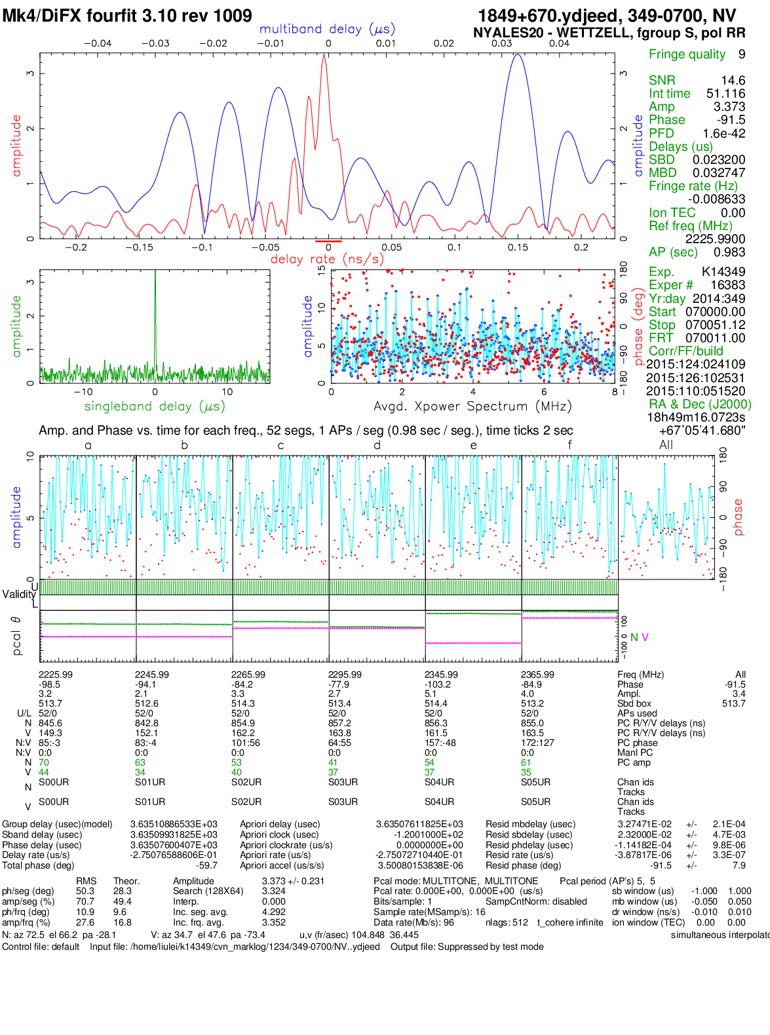
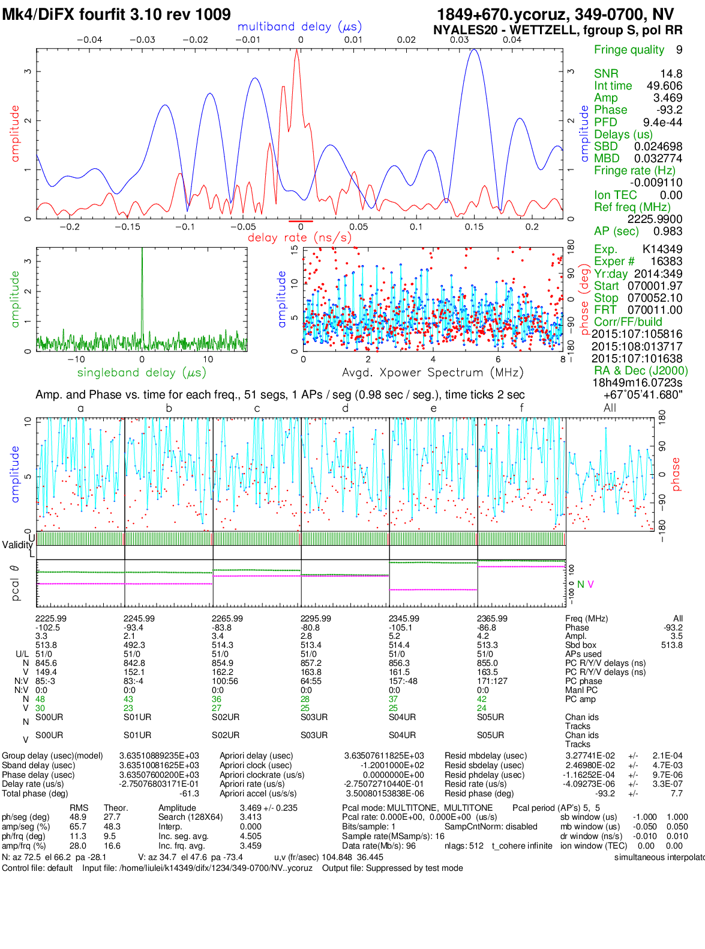
CVN
DiFX

Slide 20
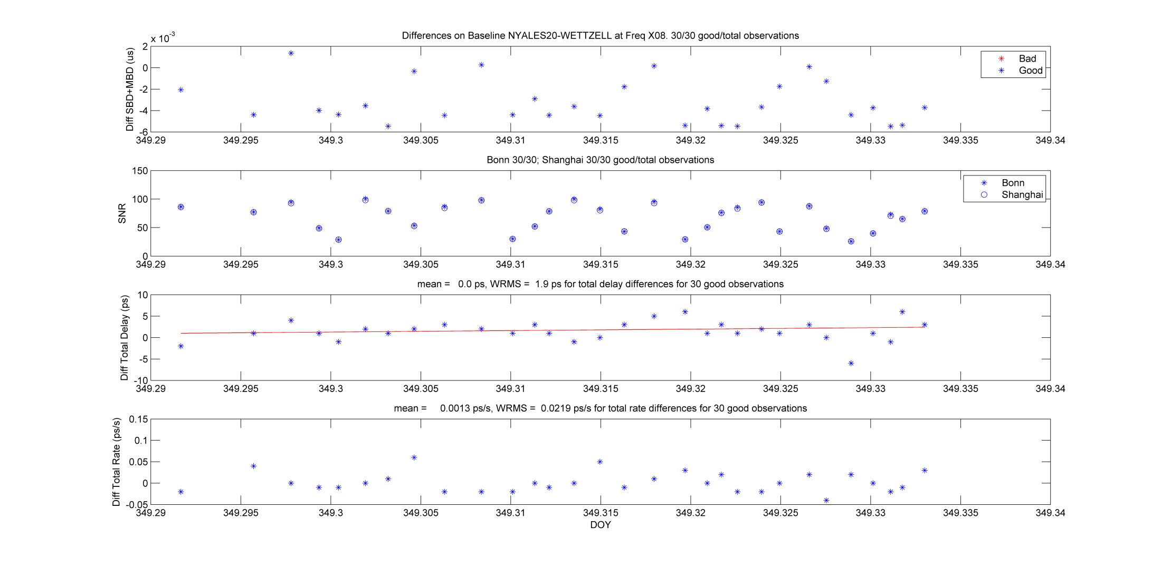
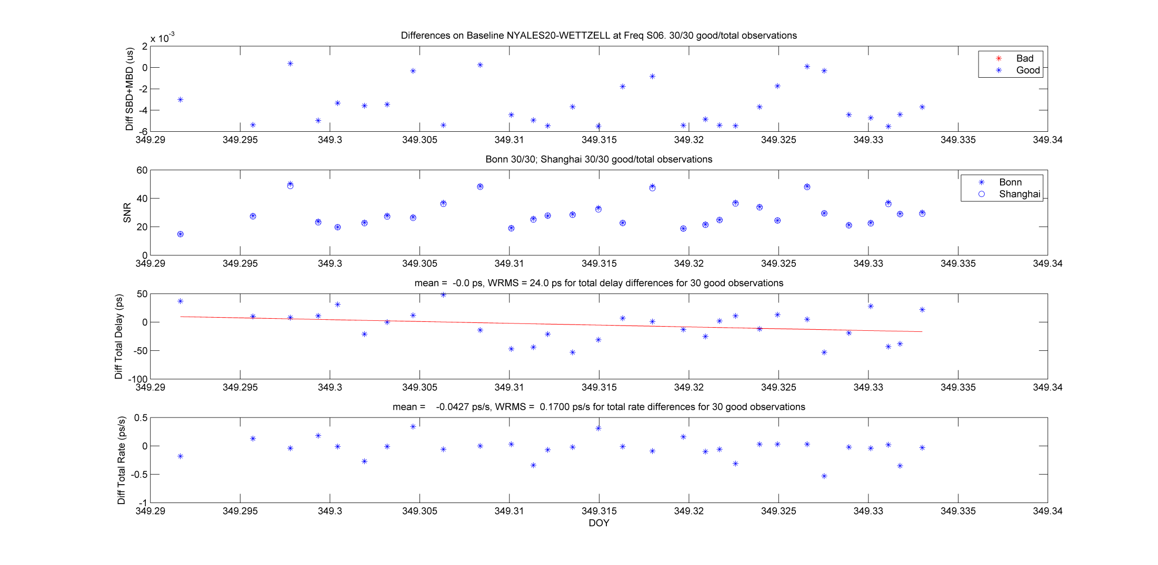
DiFX vs. CVN SC

Slide 21
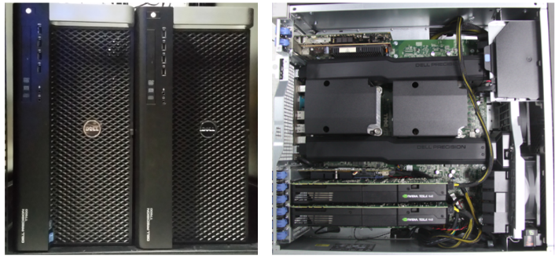
GPU acceleration correlator prototype
Two GPU Nodes
Each node:1 x Nvidia K40c
GPU Workstation | DELL T5600
Chipset | Intel C600
CPU | Intel E5-2600 @ 2.00GHz
Memory | 64GB
Ethernet | Intel 82579 1Gb NIC
Infiniband | Mellonax ConnectX 40Gb/s QDR
GPU | NVIDIA Kepler K40c

Slide 22
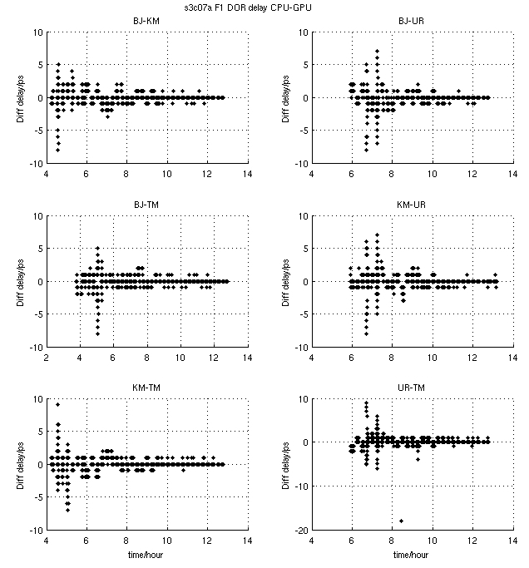
CE-3 DOR delay difference: GPU SC vs. CPU SC
Four station speed test
NVIDA K40C
GPU | Speed/station
1 node | 337Mbps
2 nodes | 670Mbps

Slide 23
Pulsar B0329+54 preliminary result
20s integration without pulsar gate and dispersion correction
20s integration with pulsar gate and dispersion correction

Slide 24
4. Future work
CVN needs a general purpose software correlator:
Lunar and deep space exploration mission
Geodesy and astronomy data processing
Pulsar binning, multi-phase center ability
VGOS broadband ability
New software correlator
CVN, IVS(VGOS), EVAN, AOV

Slide 25
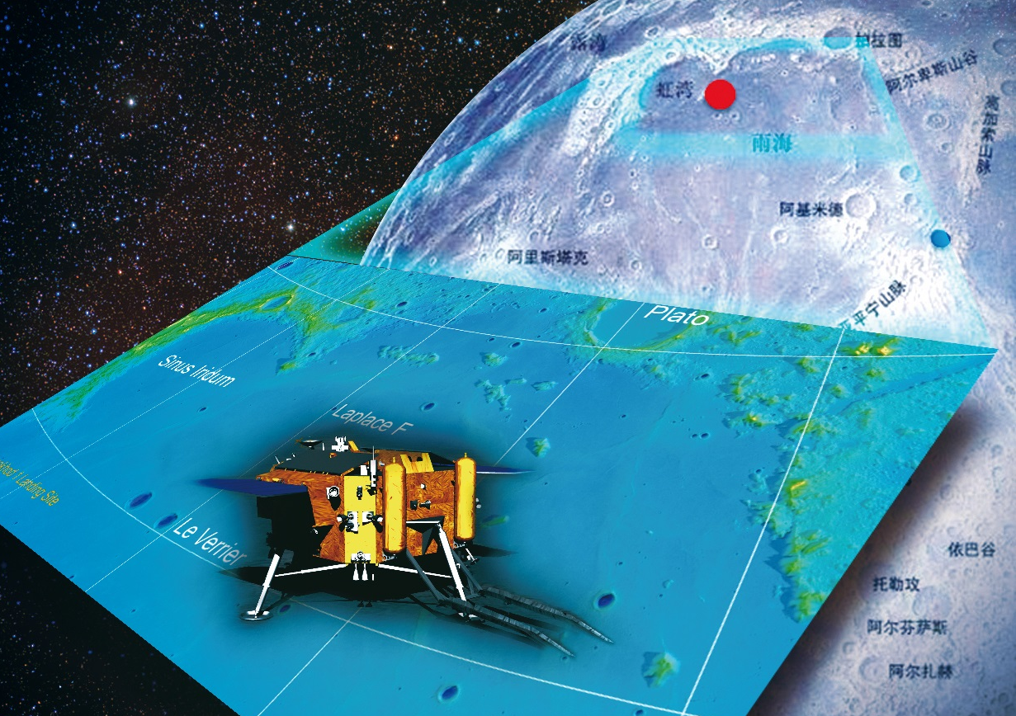
Thank you for your attention!

Slide 26
Rover position （4 ways）
Site |  | Visual+ Inertial navigation | VLBI group delay | VLBI phase delay | VLBI phase reference map
A | N | 9.03 | -4.2 | 11.25 | 9.47
 | E | 1.55 | .4 | 1.28 | 1.15
B | N | 5.00 | -269.8 | 5.89 | 5.12
 | E | 8.90 | -640.8 | 7.56 | 9.30
C | N | -5.65 | 80.5 | -4.92 | -5.34
 | E | 8.36 | 10.0 | 8.02 | 8.86
D | N | -9.75 | 112.6 | -8.73 | -9.51
 | E | 0.27 | 69.2 | 0.37 | 0.49
E | N | -19.77 | 59.0 | -17.35m | -19.26
 | E | -0.20 | 32.0 | -0.42 | -0.29
E17 | N | -11.83 | / | / | -11.063
 | E | -13.05 | / | / | -12.961

Slide 27
Residual statistics
VLBI group delay residuals：
~ 1ns in trans-lunar orbit
~ 0.5ns in lunar orbit.

Slide 28
The result of CVN software correlator using the fast fringe search function. The show tool is real-time monitoring tool developed by ourselves.
Fast fringe search is closed!
Fast fringe search is opened!

Slide 29
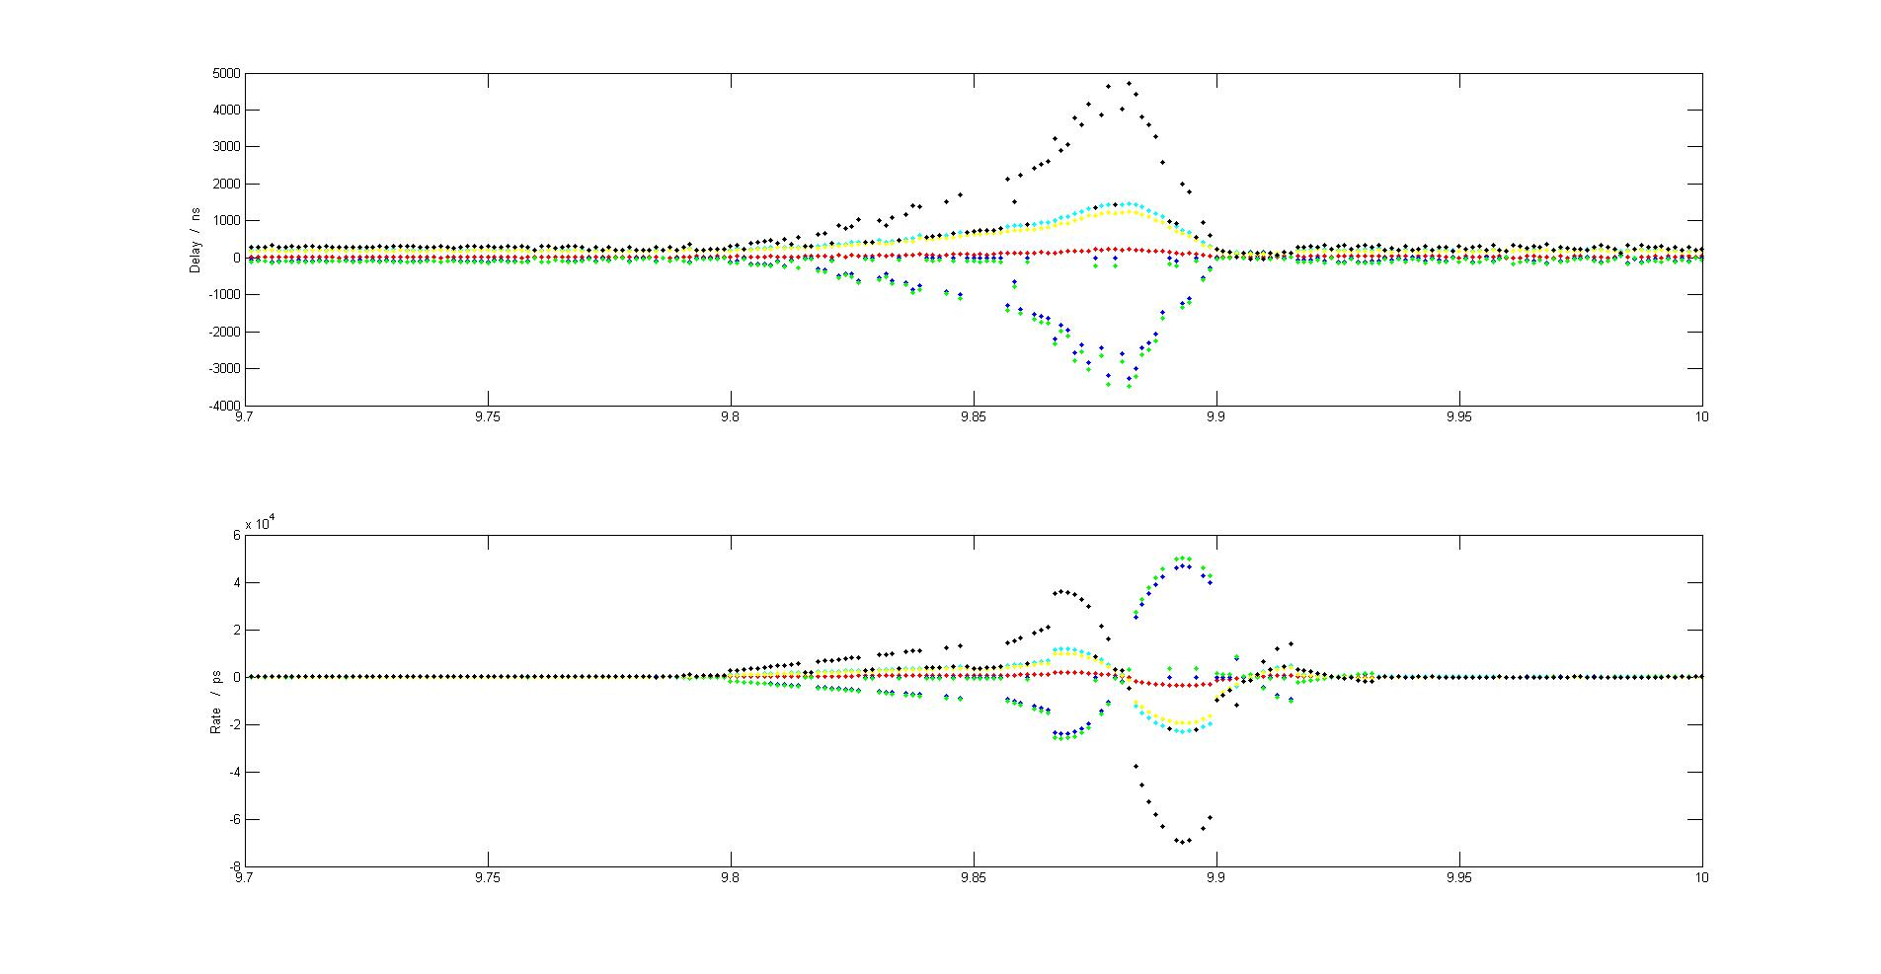
Perilune braking real time fringe search result

