Slide 1
電波天文学”最後の弱点”の克服
Junji Inatani (NAOJ)

Slide 2
電波天文学50年
“新興勢力”電波天文の弱点
  空間分解能
  線スペクトル(分光学)
  検出感度
“弱点”から”得意芸”への転化
  転化の契機:
    アンテナ大型化の技術(制御する光学系)
    波の性質の徹底的利用(干渉技術)
    高速デジタル信号処理
    星間分子の発見､ミリ波サブミリ波への着目
    低温物性の利用､化合物半導体､超伝導デバイス
最後(?)の弱点 → 観測視野(FOV)

Slide 3
私の問題意識
電波天文は長らくシングルビームでやってきた
  シングルビームの制約があるからこそ、究極の感度競争で生きてきた
  光赤外天文では、”視野のある観測”が当たり前
  シングルビームは電波の宿命か？
近年、電波天文でもDirect Detectionのセンサ集積が発展
  ミリ波サブミリ波カメラ(TESボロメータ､MKID)
  原始銀河探査、CMB観測、等で成果
他方、”THzブーム”の中、半導体集積デバイスの進捗が著しい
  化合物半導体のみならず、シリコン・デバイスもTHz応用へ
  Heterodyneも含めて、集積化の展望が見えてきたのではないか？
電波分光でも”視野のある観測”は可能なはず
  たとえば、NRO45m鏡に1万画素(100x100)のヘテロダインカメラがのるか？
  新規に広視野アンテナを最適設計すれば、どこまで可能か？
  制約条件を明らかにしたい

Slide 4
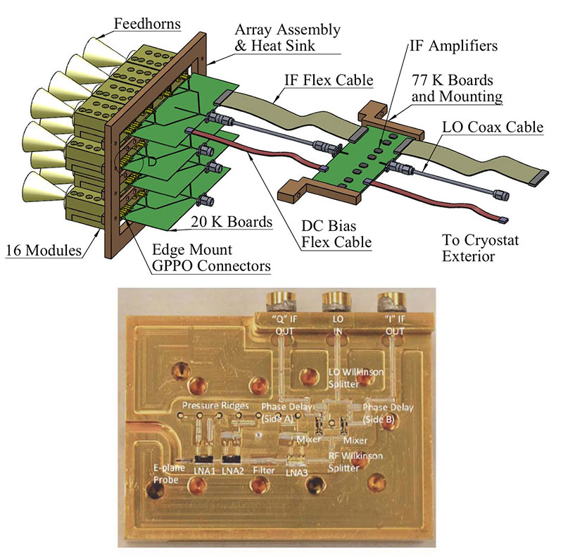
野辺山でもいろいろやってきたが･･･
SIS115Q (4 beams)
BEARS (25 beams)
FOREST (4 beams,2SB)
“Argus”
(NRAO, GBT, 2014)
16 beams, HEMT
The latest state-of-the-art module tested at Caltech has a minimum receiver noise temperature of 27 K, and with less than 40 K noise in the range of 75-107 GHz.
The projected band averaged receiver noise temperature is 50 K in the 75-115.3 GHz range.
Argus is scheduled to be deployed at the GBT by November 2014

Slide 5
CCAT(25m)のHPを見ると････

Slide 6
CCAT: Heterodyne Camera

Slide 7
SPIE Conference 9153 (June 2014)
Millimeter, Submillimeter, and Far-Infrared Detectors and Instrumentation for Astronomy VII
Session-1 (Current/Near-Term Cameras and Arrays)
The NIKA 2013-2014 observation campaigns: control of systematic effects and results,
SCUBA-2: an update on the performance of the 10,000 pixel bolometer camera after 2 years of science operation at the JCMT,
The status of MUSIC: the multiwavelength sub/millimeter inductance camera,
The ArTeMiS wide-field submillimeter camera : on-sky performance at 350 microns,
The current status of MAKO,
ZEUS-2: on-sky performance, integration of 215/645 micron TES bolometer arrays, and an optimized diffraction grating,
Session-2 (Transition-Edge Sensors: Theory and Design)
Focal plane arrays for BETTII: the Balloon experimental twin telescope for infrared interferometry,
Scalable background-limited polarization-sensitive detectors for mm-wave applications,
Session-3 (Transition-Edge Sensors: Performance and Developments)
Development of TES arrays using DRIE for the short wavelength band of the SAFARI Instrument on SPICA,
TES-microstrip spectrometers for the tomographic ionized carbon mapping experiment (TIME): a new probe of reionization,

Slide 8
SPIE Conference 9153 (June 2014)
Millimeter, Submillimeter, and Far-Infrared Detectors and Instrumentation for Astronomy VII
Session-4 (Future Cameras and Arrays)
The next-generation BLASTPol experiment,
GISMO-2: a two color millimeter camera for the IRAM 30-m telescope,
MUSTANG2: millimeter astronomy on large single dish telescopes,
The kilopixel array pathfinder project (KAPPA): a 16-pixel integrated heterodyne focal plane array: characterization of the single pixel prototype,
SWCam: the short wavelength camera for the CCAT observatory,
SuperSpec: a broadband on-chip millimeter-wave spectrometer for high redshift galaxy surveys,

Slide 9
SPIE Conference 9153 (June 2014)
Millimeter, Submillimeter, and Far-Infrared Detectors and Instrumentation for Astronomy VII
Session-5 (Coherent Detector Technology)
Argus: a 16-pixel millimeter-wave spectrometer for the Green Bank telescope,
Session-7 (CMB Instruments: Current and Near-Term)
Design, deployment, and operation of ACTPol, a millimeter wavelength, polarization sensitive receiver for the Atacama Cosmology telescope,
The performance of the bolometer array and readout system during the recent flight of the E and B experiment (EBEX),
BICEP2 and Keck array: upgrades and improved beam characterization,
Pre-flight integration and characterization of the SPIDER balloon-borne telescope,
Session-8 (Optics and Components)
Optical design for the 450 μm, 350 μm, and 200 μm ArTeMiS camera,

Slide 10
SPIE Conference 9153 (June 2014)
Millimeter, Submillimeter, and Far-Infrared Detectors and Instrumentation for Astronomy VII
Session-10 (CMB Instruments: New Developments I)
The Simons array: expanding POLARBEAR to three multi-chroic telescopes,
POLARBEAR-2: a new instrument for CMB polarization measurements with Simons Array,
PILOT: a balloon-borne experiment to measure the polarized FIR emission of dust grains in the interstellar medium,
The cosmology large angular scale surveyor (CLASS): 40-GHz detector array of bolometric polarimeters,
Session-11 (CMB Instruments: New Developments II)
Advanced ACTPol,
The primordial inflation polarization explorer (PIPER),
GroundBIRD: CMB polarization measurements at large angular scale by using MKIDs,
BICEP3: a next-generation refractor for inflationary CMB polarization,
SPT-3G: a next-generation cosmic microwave background polarization experiment on the South Pole telescope,

Slide 11
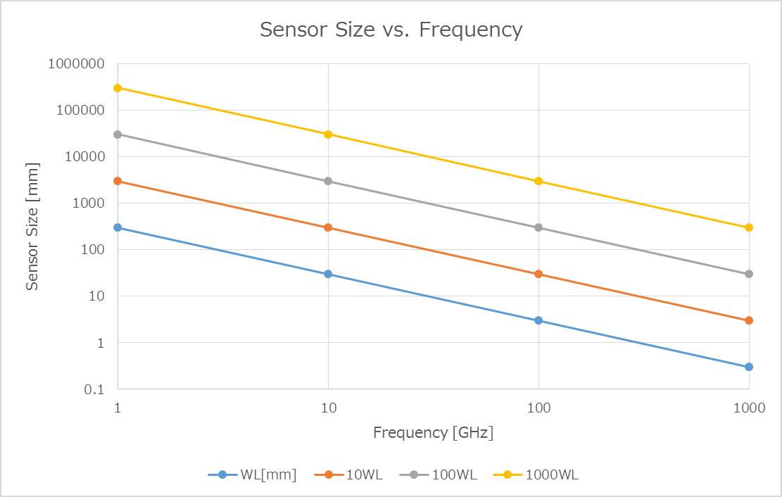
電波カメラの画素数の制約
>2GHzでは10x10画素以上､ >20GHzでは100x100画素以上､ >200GHzでは1000x1000画素以上が可能か(物理サイズ1m以下)｡

Slide 12
課題1 (広視野のアンテナ)
光赤外ではレンズによる補正光学系を多用
  電波では､(1)鏡のみ､(2)電波レンズ利用､のtrade-offが必要｡
  反射鏡による補正技術(RC etc.) → 電波への拡張｡
複数ミラーを含む非対称光学系の取り扱い
  Dragonne Designで等価な対称光学系がつくれる場合がある
  ただし､Single Feedに限定 → 複数Feedの場合の設計法
設計手法
  光線追跡法 vs. 物理光学
  評価条件の違い

Slide 13
双曲面、放物面、楕円面
Karl Schwarzschildの式
K: conic constant
K=0 spherical
-1<K<0 : elliptical
K = -1 : parabolic
K < -1 : hyperbolic
R: radius of curvature at center
NRO 45m
(R=32m)
でKを変える場合の実変形量
この程度なら可能ではないか？
“TMT”は
K = -1.00095
変形量[mm]
主鏡半径 [mm]

Slide 14
C. Dragone (1978)
“Offset Multireflector Antennas with Perfect Symmetry and Polarization Discrimination” Bell System Technical Journal, vol.57, 2663 (1978)
- Offset Cassegrain, Offset Gregorian の交差偏波消去条件を一般化
- 対称性回復の条件をグラフィカルに解明
main-ref
main-ref
subref
feed
feed
subref
Offset Cassegrain
Offset Gregorian

Slide 15
Ray Tracing for Multi-Feed Application
[mm]
[mm]
OPD1
OPD2
OPD1
OPD2
[mm]
[mm]
dφ(Beam)=1.78 deg
dφ(Feed)=0.78 deg
dφ(Feed)=3 deg
dφ(Feed)=4 deg
[mm]
[mm]
[mm]

Slide 16
Crossed Dragone
main-ref
subref
OPD1
OPD2
feed
dφ(Feed)=5 deg
dφ(Beam)=3.21 deg

Slide 17
課題2 (ヘテロダイン･カメラ)
要素技術は?
  Feed, LO, LNA → 基本的にYes
  伝送線路､受動回路 → 基本的にYes
  高感度Mixer → Si/GaAs/超伝導?
  集積技術: Hybrid vs. Monoliothic
排熱設計は?
  ex. HEMT: 1V*5mA*2stage*100*100 = 100W @20K
  LNAの消費電力低下が必要: Reduction by 10 will be feasible.
超広帯域信号処理をどうするか?
  ex. 4GHz*100*100 = 40THz
  ex. ALMA: 4GHz*2sb*2pol*66antenna = 1056GHz
  CMOSの発展に期待

Slide 18
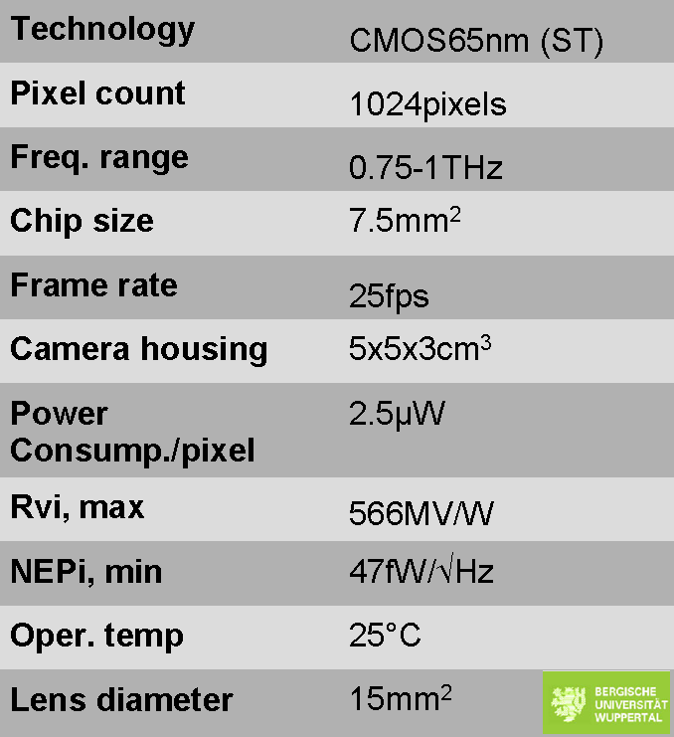
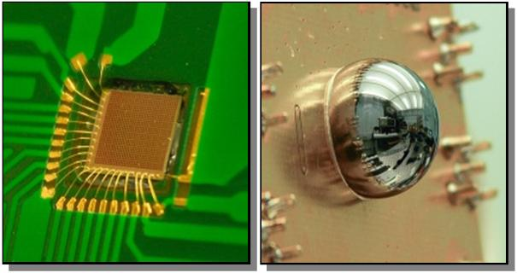
CMOS THz Camera
The University of Wuppertal, STMicroelectronics, and ISEN/IEMN presented the world’s first Terahertz video camera fully integrated in a commercially available CMOS 65nm process technology from STMicroelectronics at the ISSCC 2012 in San Francisco.

Slide 19
ISSCC 2012
IEEE International Solid-State Circuits Conference, San Francisco, February 19-23, 2012
A 1kpixel CMOS camera chip for 25fps real-time terahertz imaging applications.
280GHz and 860GHz image sensors using Schottky-barrier diodes in 0.13μm digital CMOS.
A 0.28THz 4×4 power-generation and beam-steering array.
A 283-to-296GHz VCO with 0.76mW peak output power in 65nm CMOS.

Slide 20
ISSCC 2013
IEEE International Solid-State Circuits Conference, San Francisco, February 17-21, 2013
A 260GHz amplifier with 9.2dB gain and -3.9dBm saturated power in 65nm CMOS.
A 93-to-113GHz BiCMOS 9-element imaging array receiver utilizing spatial-overlapping pixels with wideband phase and amplitude control.
A 94GHz 3D-image radar engine with 4TX/4RX beamforming scan technique in 65nm CMOS
(BiCMOS: Bipolar + CMOS)

Slide 21
SiGe HBT (Heterojunction Bipolar Transistor)
HBT:
SiGe系ではIBMによる研究が20年以上前から行われているが、Bi-CMOSプロセスに組み込まれるようになってからは集積化と高速化が進み、 2005年の時点で0.13μmプロセス世代において遮断周波数において210GHzが達成されている。
また、他の最高速動作事例としてはInP系では 2007年時点でイリノイ大にてFmax=710GHz、UCSBから780GHzの記録などが報告されている。
(http://ja.wikipedia.org/wiki/HBT)
The HEMT noise at low microwave frequencies depends upon
the gate leakage current ranging from 0.1 μA (denoted as 0 uA) for selected transistors to 1 μA for a mediocre transistor.
S.Weinreb et al.
IEEE TRANSACTIONS ON MICROWAVE THEORY AND TECHNIQUES, VOL. 55, NO. 11, NOVEMBER 2007
Measurements of these quantities are reported for SiGe transistors from the IBM SiGe BiCMOS-8HP 0.12-μm process.
The measured noise temperature in the 0.7–3-GHz range and the modeled noise temperature to 20 GHz are comparable to that measured with the best 0.1-μm InP HEMT transistors, yet SiGe has advantages of on-chip integration with CMOS, very high yield, a rich stable of accurate passive components, and a more rapid development pace.

Slide 22

DOTSEVEN Towards 0.7 Terahertz Silicon Germanium Heterojunction Bipolar Technology
http://www.dotseven.eu/
DOTSEVEN is a very ambitious 3.5 year R&D project targeting the development of silicon germanium (SiGe) heterojunction bipolar transistor (HBT) technologies with cut-off frequencies (fmax) up to 700 GHz.
Special attention will be paid to clearly demonstrate the manufacturability and integration with CMOS as well as the capabilities and benefits of 0.7 THz SiGe HBT technology by benchmark circuits and system applications in the 0.1 to 1 THz range.

Slide 23
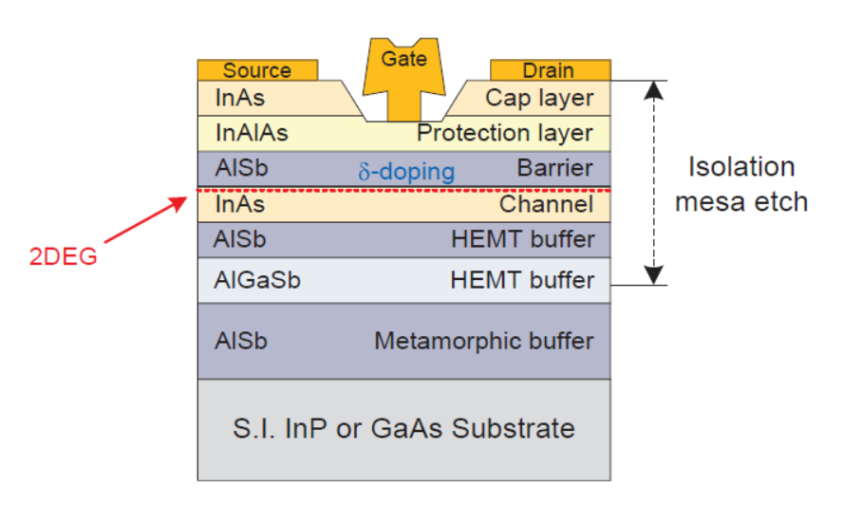
Low Power Consumption
“Ultra-Low Power InAs/AlSb HEMTs for Cryogenic Low-Noise Applications”
by Giuseppe Moschetti (Chalmers University of Technology), 2012
A three-stage low noise amplifier operating in the 4-8GHz frequency range.
At 13K, a minimum noise temperature of 19K and a gain above 24 dB were measured at a total DC power consumption of only 6mW.
This corresponded to an ultra-low power consumption of only 600μW in the HEMT device.

Slide 24
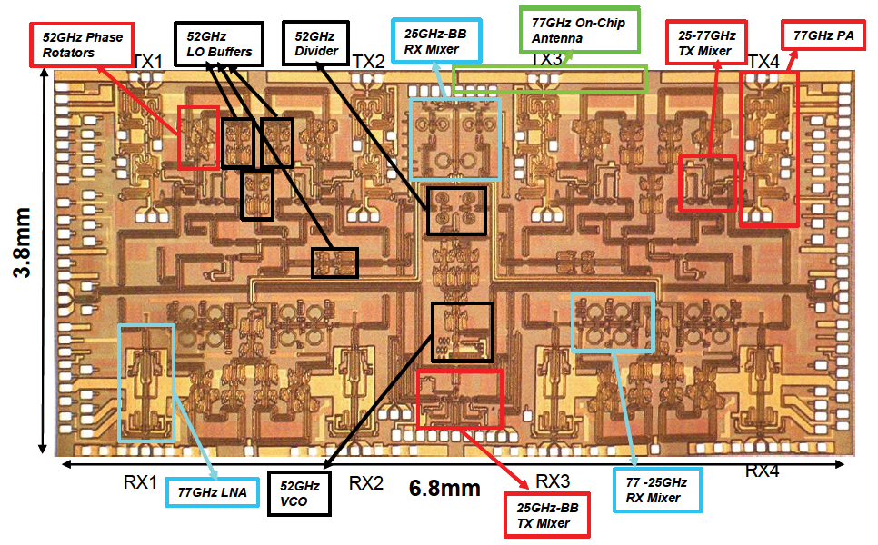
mm-Wave Silicon ICs (Ali Hajimiri, Caltech)

Slide 25
mm-Wave Silicon ICs (Ali Hajimiri, Caltech)
A fully integrated 4-element phased array transceiver with onchip antennas has been designed and fabricated in a 130nm SiGe BiCMOS process.
The receiver consists of the complete down-conversion path with low-noise amplifier (LNA), frequency synthesizer, phase rotators, combining amplifiers, and onchip dipole antennas.
A distributed active combining amplifier at an IF of 26 GHz is used to perform the signal combining. A 52-GHz first LO is generated on chip and is routed to different elements,
where it is phase shifted locally by the phase rotators. The local LO-path phase-shifting scheme enables a robust distribution network that scales well with increasing frequency and number of elements while providing high-resolution phase shifts.
Measurements indicate a single-element LNA gain of 23 dB and a noise figure of 6.0 dB.
Each of the four receive paths has a gain of 37 dB and a single-path overall noise figure of 8.0 dB. Each on-chip antenna has a gain of +8 dBi.
Each element of the 2-step upconversion transmitter generates +12.5 dBm of output power at 77 GHz with a bandwidth of 2.5 GHz leading to a 4-element effective isotropic radiated power (EIRP) of +24.5 dBm.
Each on-chip PA has a maximum saturated power of +17.5dBm at 77 GHz. The entire phased array transceiver occupies an area of 3.8mm x 6.8mm, as shown in the die photo of Fig. 1.

Slide 26
まとめ
広視野のヘテロダイン受信機を本気で考える時期に来た
集積戦略についてのロードマップをつくろう
  Device Selection
  Integration: Hybrid vs. Monolithic
  Optics
“超伝導ガラパゴス”を出て､Silicon Industryの世界へ

