Slide 1
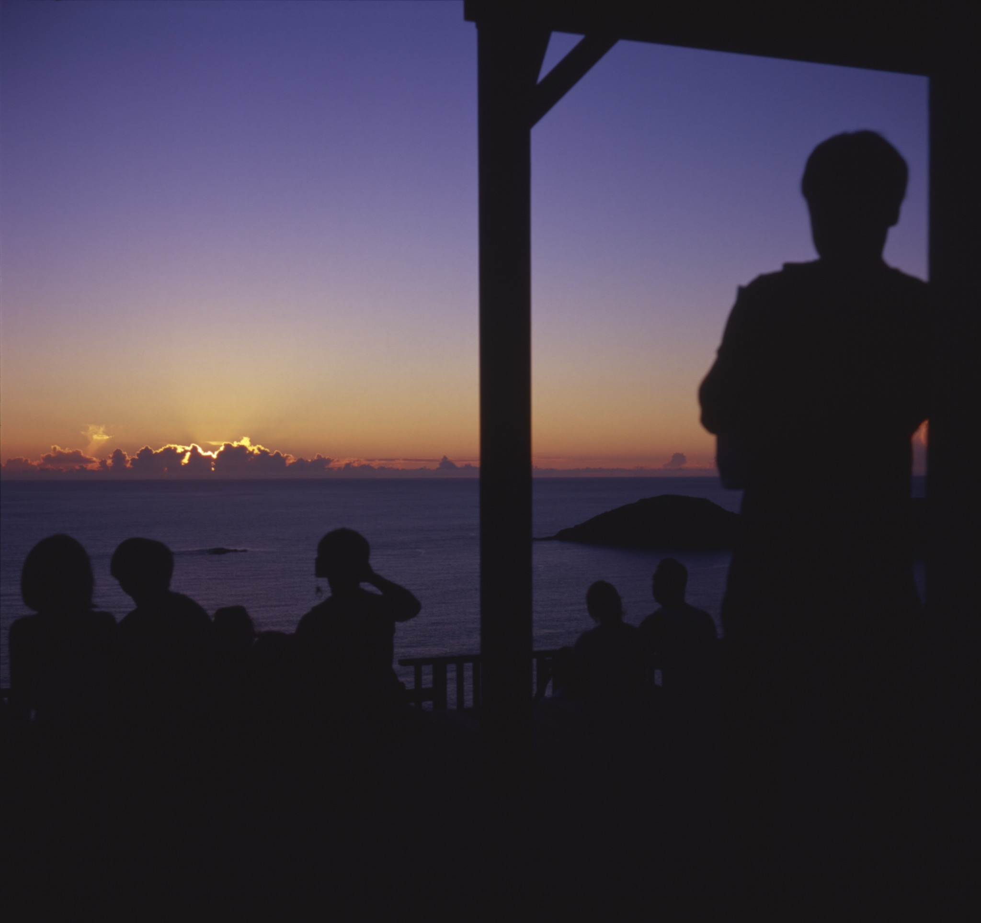
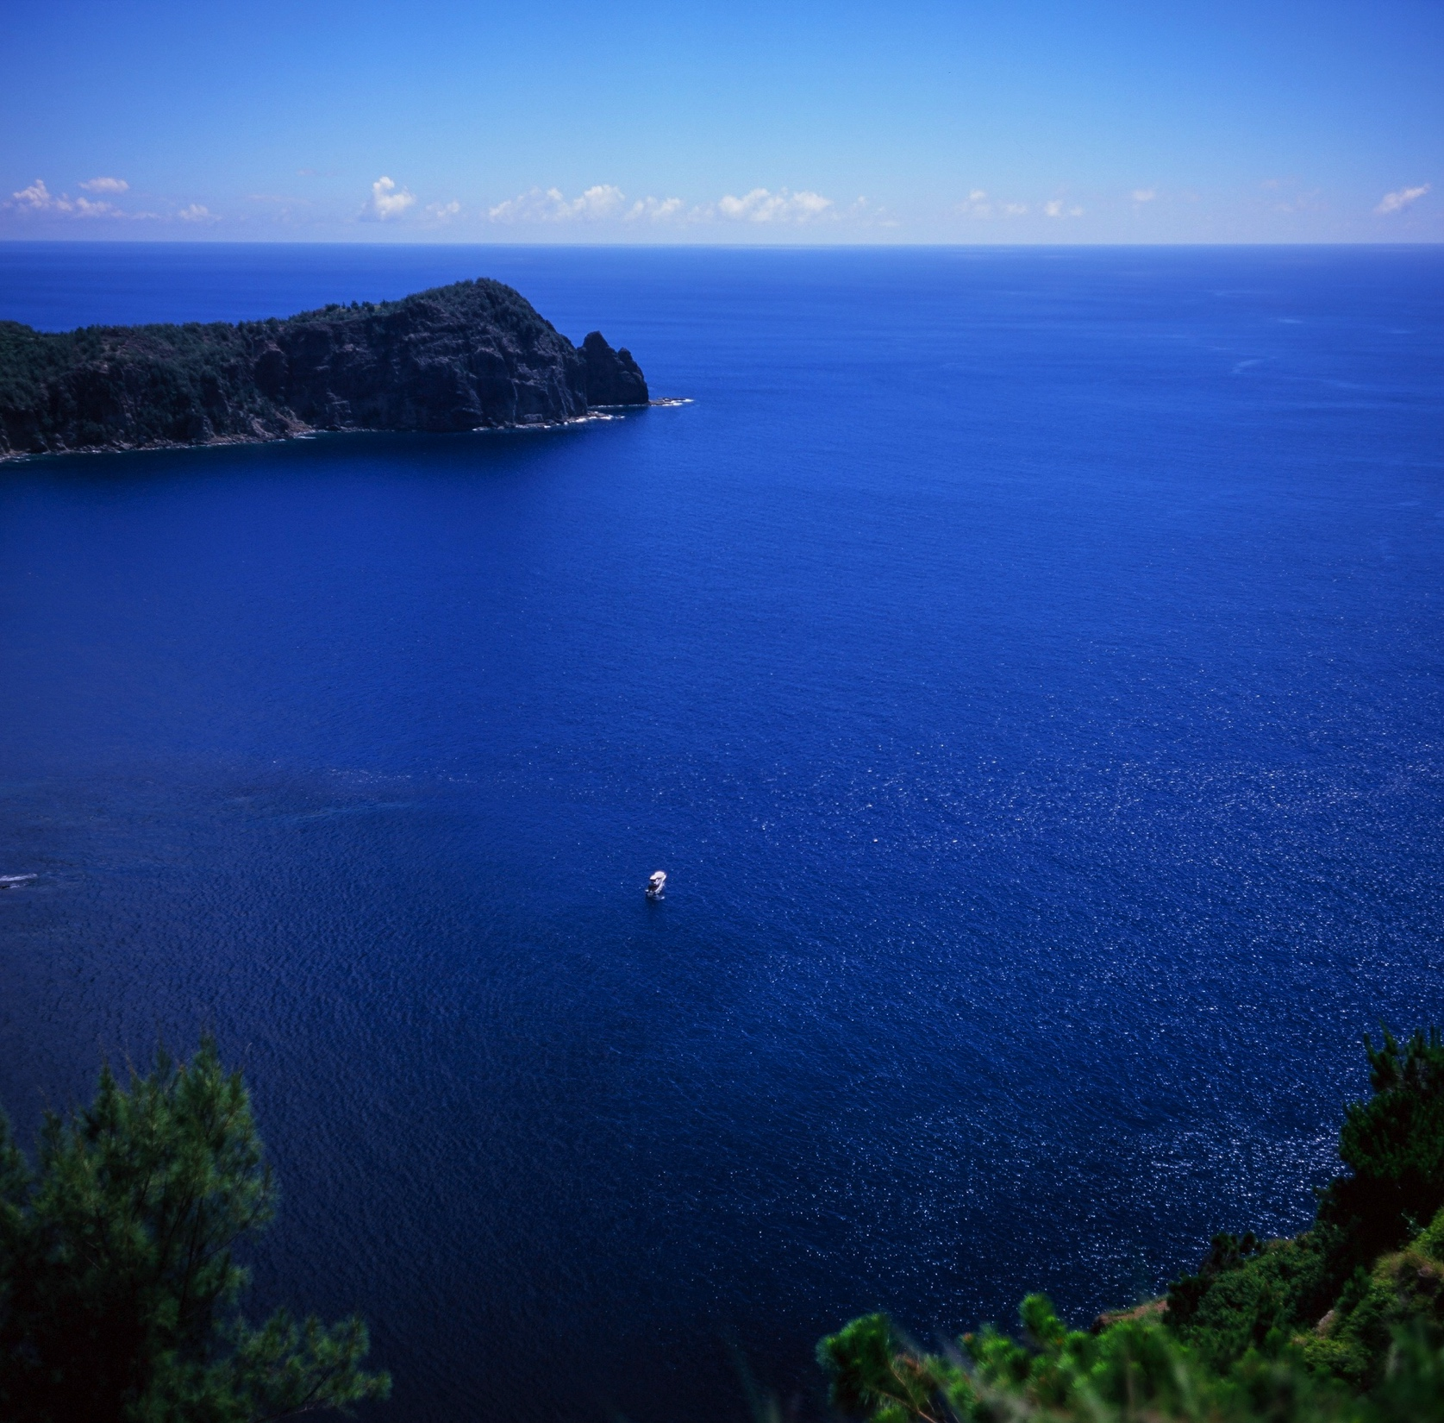
記録時に必要な情報 & 相関処理時に必要な情報
16th VERA UM 2018
Sep 25th~26th
Yuuki Adachi

Slide 2
CONTENTS
Required Item for Recording and Correlation
P.I. Responsible
Special Item on VEX schedule for VERA operation
Definition of Recording Mode
Outline of Signal Path
Outline of VEX syntax for new item
“rec” Item
“bunch” Item
Additional…
Investment for Maintain of Stable Operation
HDD broken rate
OCTADISK/RAIDBOX Occupation Cycle on VERA
Investment for Maintain of Stable Operation

Slide 3
Required Item for Recording and Correlation

Slide 4
P.I. Responsible
Make a correct vex in accordance with VEX rule
VEX rule by Nagayama
http://133.40.42.140/cgi-bin/cbag/ag.cgi?page=FileView&gid=&fCID=206581&fFID=289879&cp=fl
From Sep 2017, additional items are added
“rec” item for Recording operation
“bunch” item for Correlation Process
Template for some recording modes
Some templates by Nagayama.
http://133.40.42.140/cgi-bin/cbag/ag.cgi?page=FileView&gid=&fCID=206581&fFID=328057&cp=fl

Slide 5
Definition of Recording Mode
Rate(bps) | Bandwidth x IF | Beam | sampler
1G | 256MHz | A/A+B | DFU | Shibata | Open use
2Gx1ch | 512MHz x 1 | A | ADS1K | Shibata | Open use
4G | 512MHz x 2 | A+B | ADS1K | Shibata | Open use
NOB 4G | 512MHz x 2 | A x 2 | ADS3K | Oyama | Close use
8G | 512MHz x 4 | A x 4 | ADS3K | Oyama | Close use
12G | 512MHz x 6 | (A+B) + B x 4 | ADS1K+ADS3K | Oyama | Close use
Use Different Recorder on the basis of Recording Mode

Slide 6
Outline of Signal Path
OCTAVIA対向化系

Slide 7
Outline of VEX syntax for new item
Sample
“rec” item
Definition of Recording Process
It’s recorded in accordance with this content
“bunch” item
Definition of Bunching Parameter for Correlation
It makes a correlation, and a correlation data is generated in accordance with this content

Slide 8
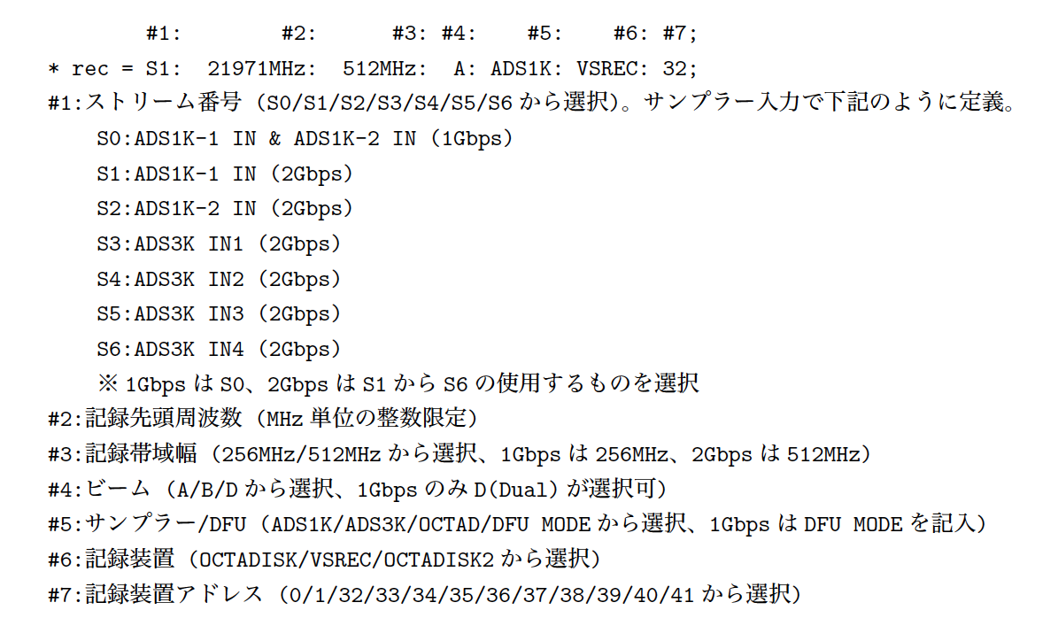
“rec” item
One Recording Process = one line
ADS1K : 1G/DFUモードにより決まるが、要設定
ADS3K : 1G/DFUモードとは独立に設定
柴田さんによる選択
(テンプレートのまま提出)

Slide 9
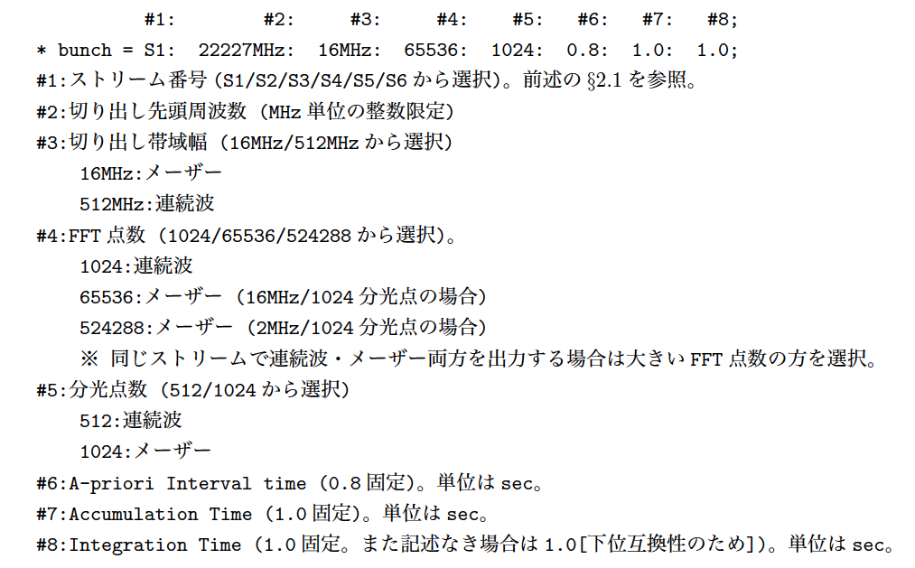
“bunch” item
What frequency do you need for output?
For 1G
> 1G

Slide 10
Additional…

Slide 11
HDD broken rate
2017/11 ~ 2018/2
3TB 34 ea. -> 108 ea./year (include Seagate)
2017/11 ~ 2018/9
3TB 102 ea. -> 122 ea./year (include Seagate)
All 127 ea. -> 152 ea./year (include Seagate 3TB)

Slide 12
OCTADISK/RAIDBOX Occupation Cycle on VERA
 | 2017 | 2018
VERA | 10 | 8
VERA (spare) | 3 | 3
KaVA | 4 | 4
For 4G

Slide 13
Investment for Maintain of Stable Operation
Around $15,000 / year for maintain
+ New Operation, Development
Replacement Cycle in 2018@fiscal year)
RAIDBOX
OCTADISK
New Development
(8TB)
OCTADISK2
CORRELATOR
Replacement OCTADISK for OD2
(3TB -> 8TB)
?
Backup for ALL
(3TB)

