Slide 1
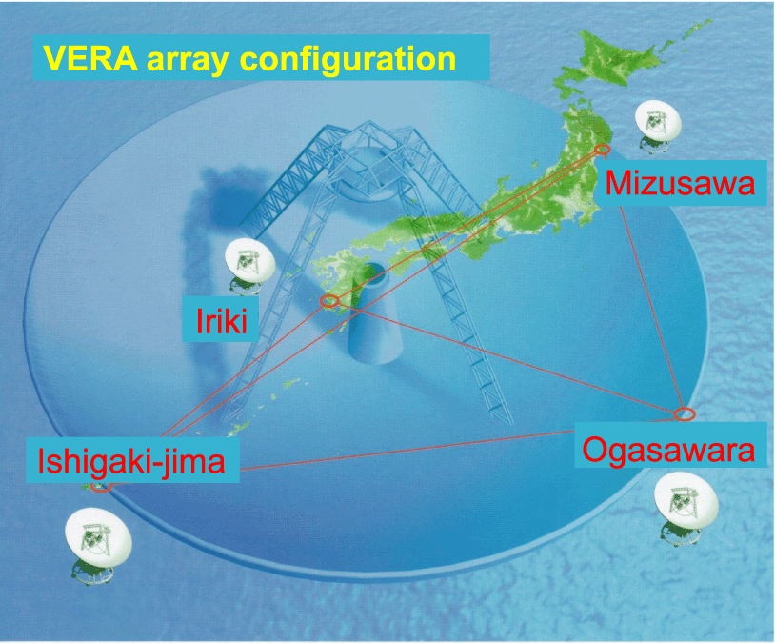
VERA SWG(Science WG)報告
Tomoya Hirota (NAOJ),
on behalf of VERA project

Slide 2
Science operation
2017-2018 season
  Total ~ 2001/3840 hours for VERA project (astrometry)
  See presentation by Shibata for more details
2018-2019 season
  Just started from September
  Need fringe-check observations before finalizing targets
 |  | number
VERA project sources (astrometry) |  | 23 (16 schedules)
 | 1Gbps | 13 (8 schedules)
 | 4Gbps | 8 (6 schedules)
 | 8/12Gbps | 3 (3 schedules)
Other VERA sources (AGN, PSR, ToO, for test) |  | 10 (5 schedules)

Slide 3
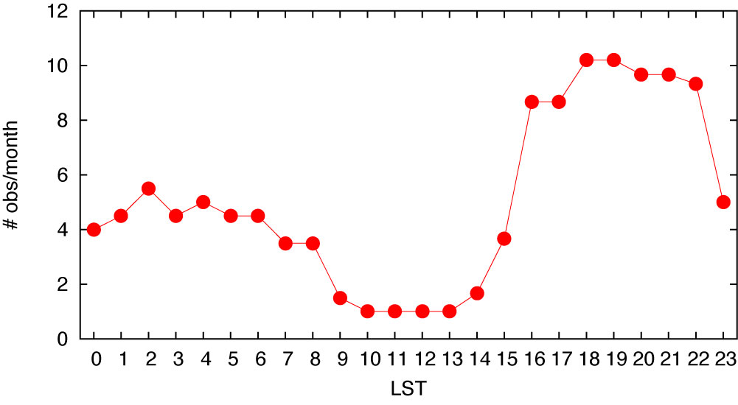
Science operation
Average number of observations in 2018-2019 season
  Just started from September
  Not including common use and KaVA (LP)
  LST around GC (LST=16-22h) is crowded
  Still room for more sources (to be allocated from October)

Slide 4
Data processing with VEDA
VEDA pipeline data processing by operation group
  Progression rate is >90%!
  Organized by Nagayama, M. K. Kim, et al.
Software developments; e.g. faster mapping code
  Under development by Adachi, Tamura, et al.
Preparation
Calibration
Phase-Ref./
imaging
Astrometry
outside AIPS
outside AIPS
Spot identification
Delay tracking
Phase-referencing
Gaussian fitting
Combine data
TBIN/CLCAL
SAD
Fixing Log files
Averaging
Doppler shift
Self calib.
Imaging
Parallax fitting
DBCON
Fringe fitting
TABED?
Summary of project
AVSPC
SETJY/CVEL
IMAGR/CALIB
TACOP/CLCAL
INDXR
Amplitude calib.
FRING/CLCAL
IMAGR
Bandpass calib
APCAL/ACCOR
BPASS
Delay tracking
Recalculation
(outside VEDA)
Other tools;
Plotting spectrum Honma
Listing log/schedule Honma
Plotting calibration data Hirota
Flagging (NOT COMPLETE) Hirota/Sato
Fringe-rate mapping Higashimura/Nakanishi/Kurayama
Library: CCcoda Kanya, Matsushita

Slide 5
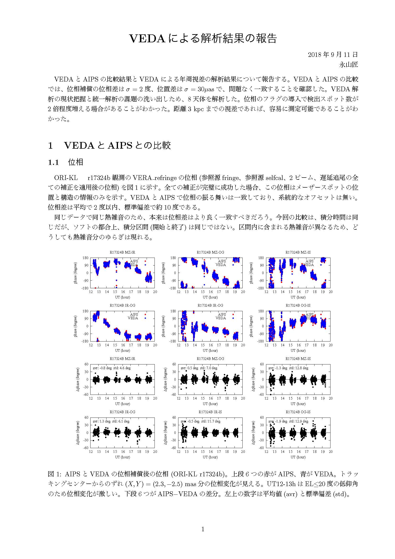
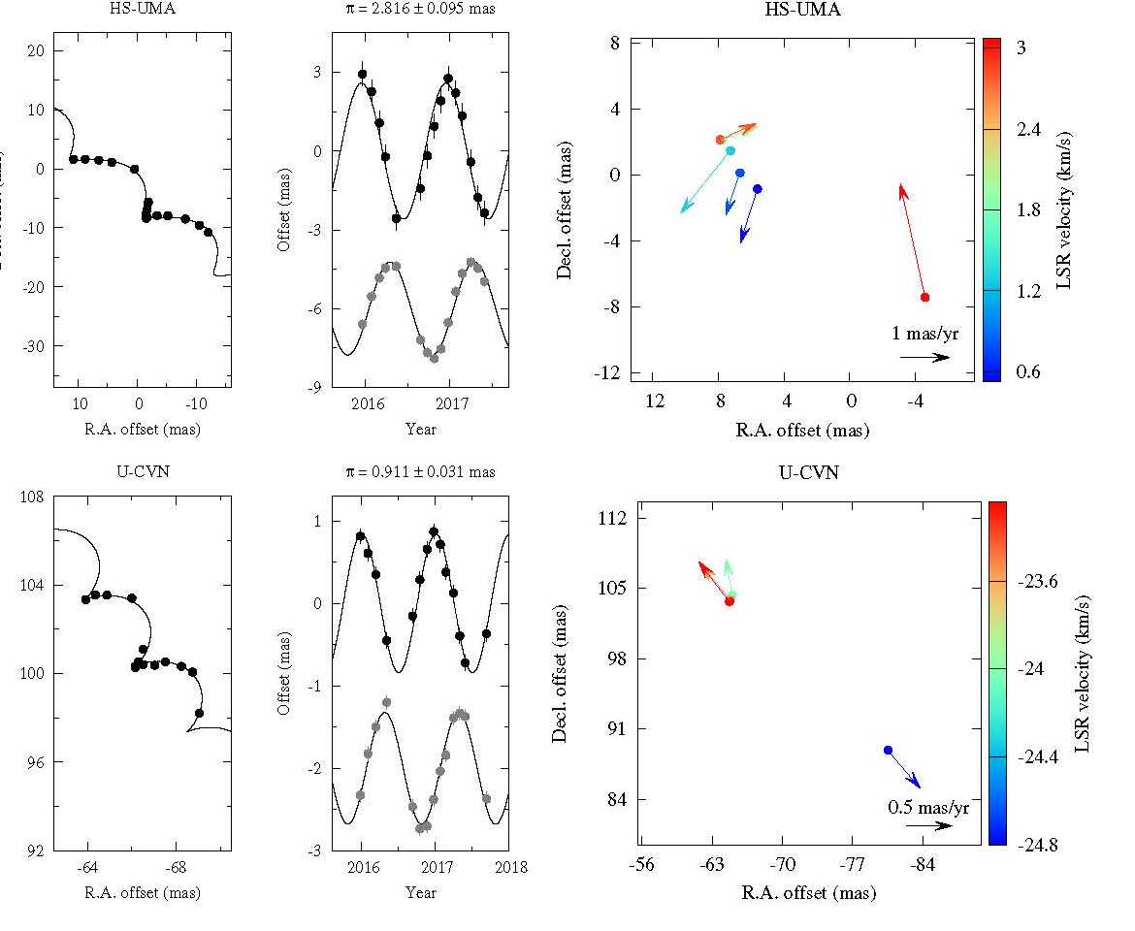
Data processing with VEDA
VEDA pipeline data processing by operation group
  Development for astrometry tools with multi-epoch data
  Tested by Nagayama et al. (in prep) for science use

Slide 6
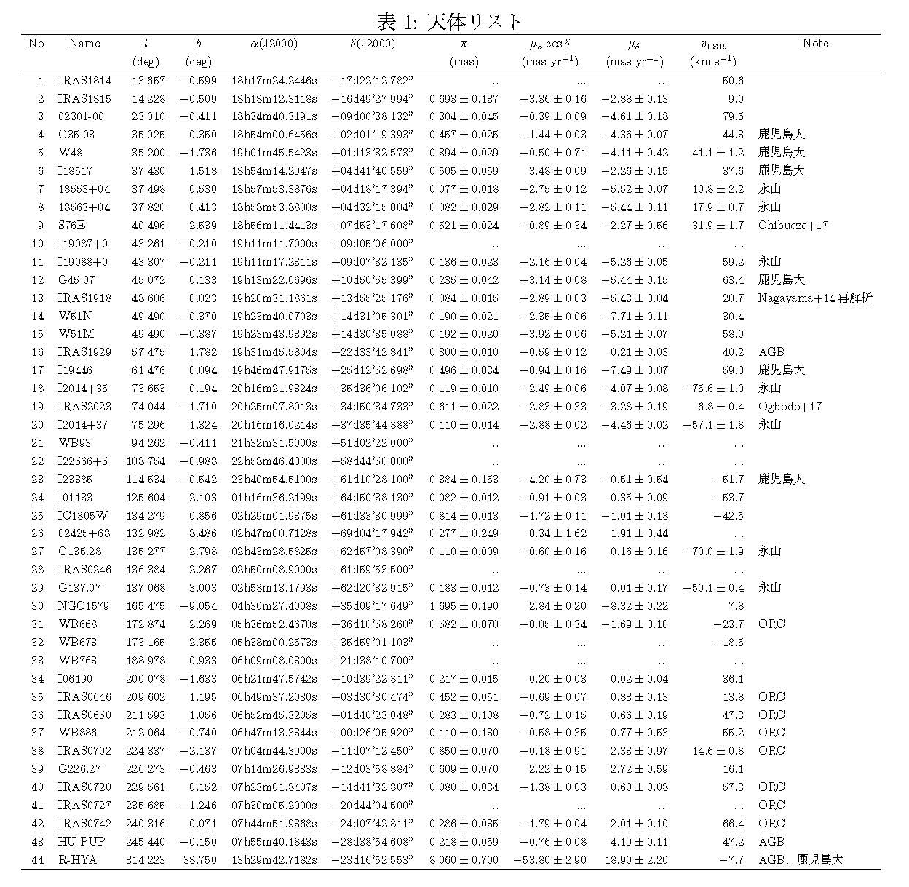
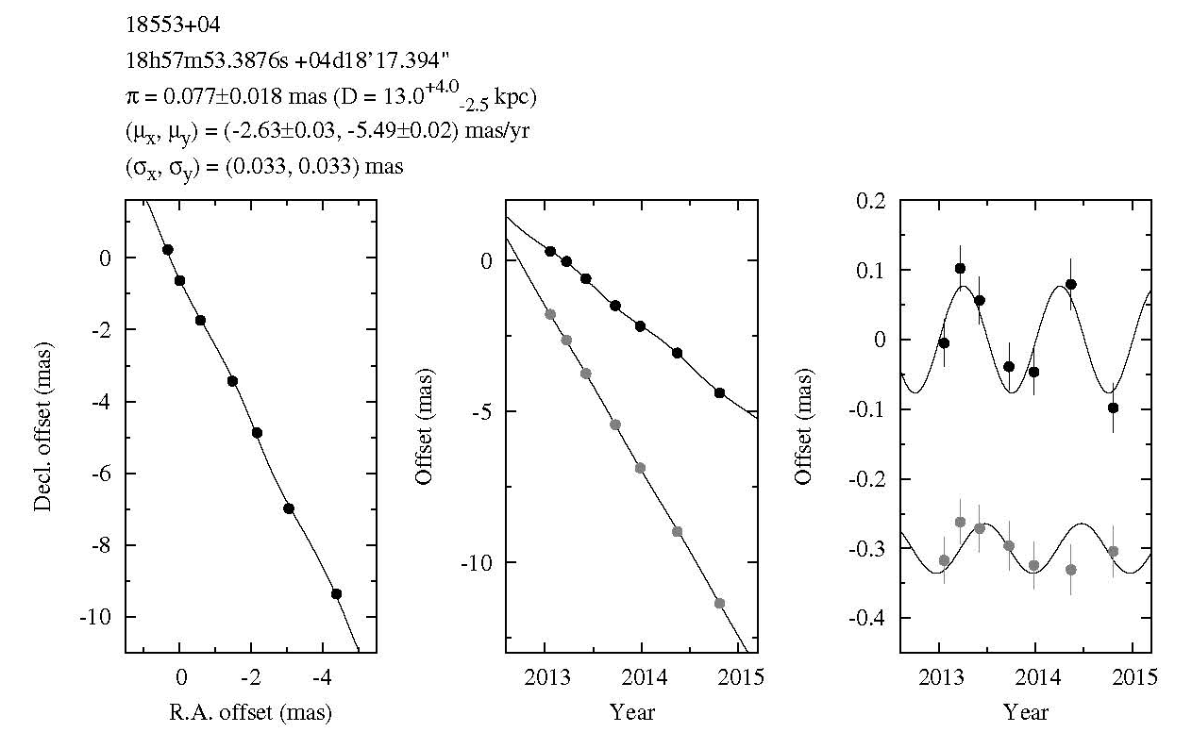
Parallax measurements
AIPS data processing to obtain parallaxes
10 kpc distances can be reached
  Thanks to great efforts by Nagayama, M. K. Kim, et al.

Slide 7
Galactic astrometry
3D structure and dynamics of Milky Way Galaxy
based on accurate astrometry at up to 10μas
Latest results (ver. July 26, 2018)
  VERA: 125 sources
  VERA+BeSSeL+EVN: 196
  Including >10kpc-sources
  R₀=7.94+/-0.25 kpc
  Θ₀=234+/-8 kms⁻¹
To be completed by 2022
March (end of FY2021)
SUN
GC
Compiled by Nagayama

Slide 8
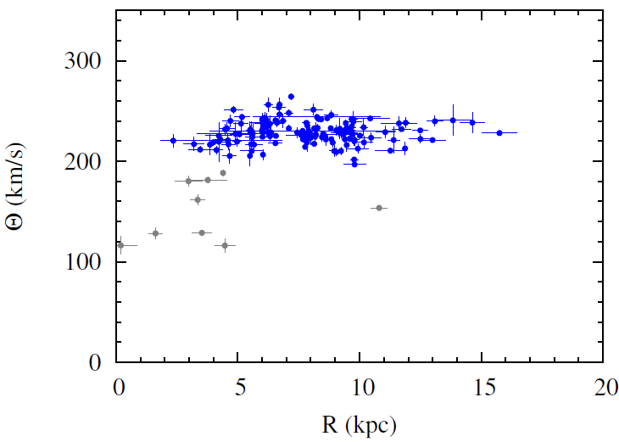
Galactic astrometry
3D structure and dynamics of Milky Way Galaxy
based on accurate astrometry at up to 10μas
Latest results (ver. July 26, 2018)
  Galactic rotation curve is nearly flat between R=5-15 kpc
Compiled by Nagayama

Slide 9
Comparison with GAIA
Comparison with GAIA DR2
  Significant difference?
  See talk by N. Sakai,
  Sudoh, Miyachi
Compiled by Nakagawa
Gaia Parallax (mas)
0.1
1
10
VLBI Parallax (mas)

Slide 10
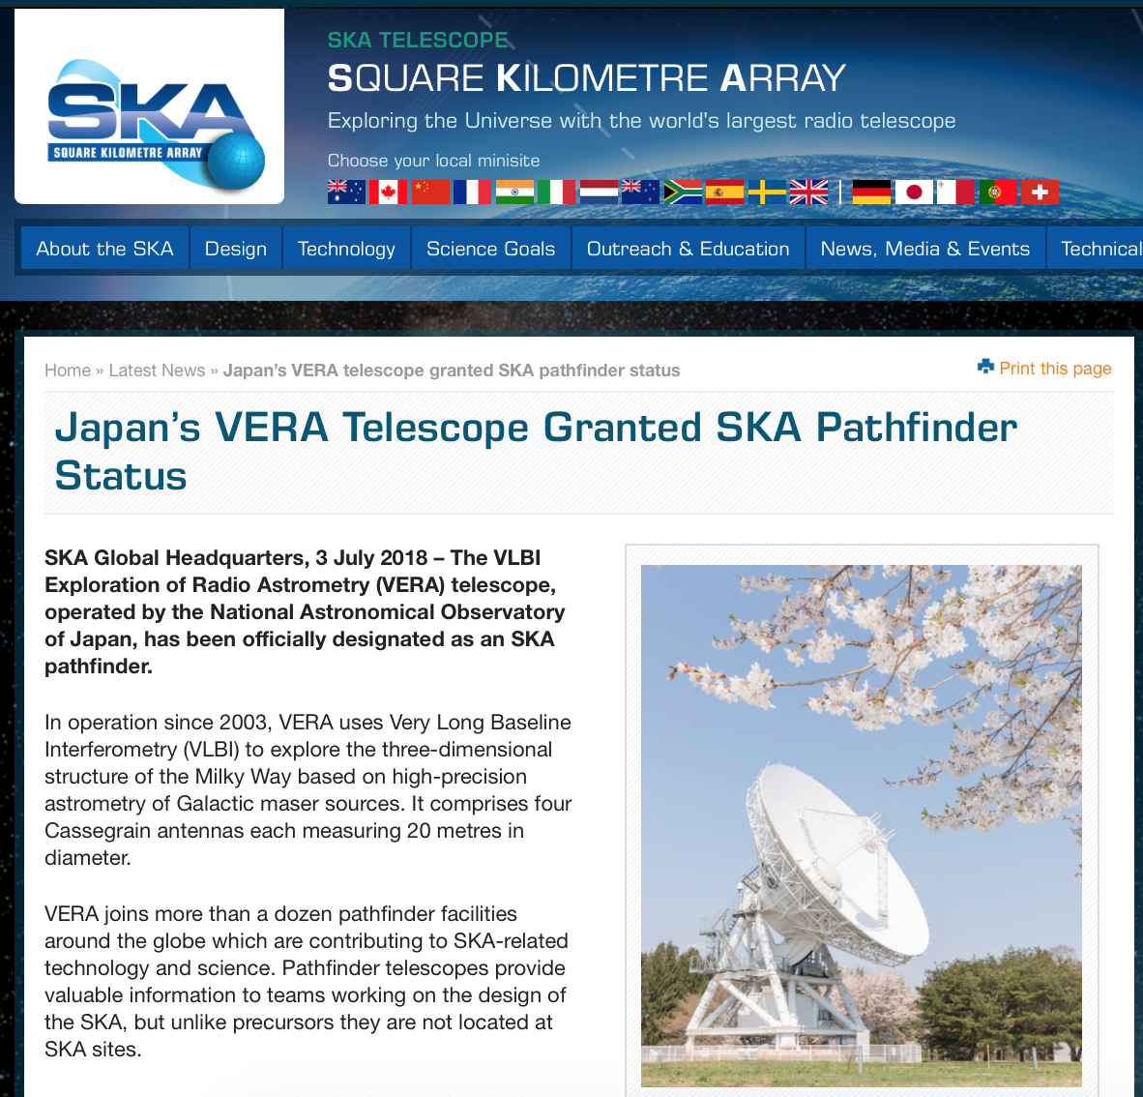
Future science plan
From VERA to KaVA, EAVN, global array (e.g TNRT)
Finally SKA and/or SKA+VLBI remote antennas
  Registered as SKA
  pathfinder (July 3 2018)
  Led by Kobayashi and
  Akahori for planning
  new project in NAOJ
Discussion in this UM

Slide 11
Summary
VERA is keeping (quasi-)steady state but gradually upgrading system performance (e.g. wide-band)
VEDA software package is almost completed
Astrometry for 10 kpc sources is feasible
VERA science project (Galactic astrometry observations) will be finished by 2022 March (end of FY2021)
  This does not mean the end of VERA array
Future plan are under discussion
  From VERA to KaVA, EAVN, global array (e.g TNRT)
  Finally SKA and/or SKA+VLBI remote antennas

