Slide 1
Measurement of the Galactic Outer Rotation Curve with VERA
H. Nakanishi¹、N. Sakai²、N. Koide¹、K. Kurahara¹、
T. Kurayama³ 、T. Nagayama⁴ and many from VERA team
(¹Kagoshima U.,²KASI, ³Teikyo U., ⁴NAOJ)
Notes:
12/13 14:15-14:30

Slide 2
Introduction
what is importance in study of the Galactic rotation curve

Slide 3
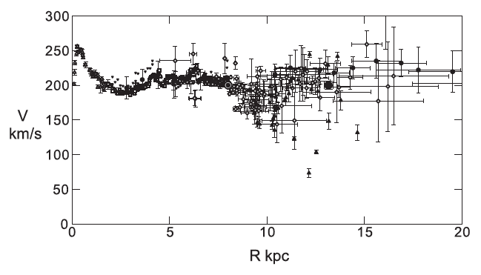
Rotation Curve of the Galaxy
Rotation curve is one of the essential parameters of the Galaxy
  Mass Distribution
  Potential
  Kinematics
←
Inner Galaxy
→
Outer Galaxy
Sofue et al. 2009

Slide 4
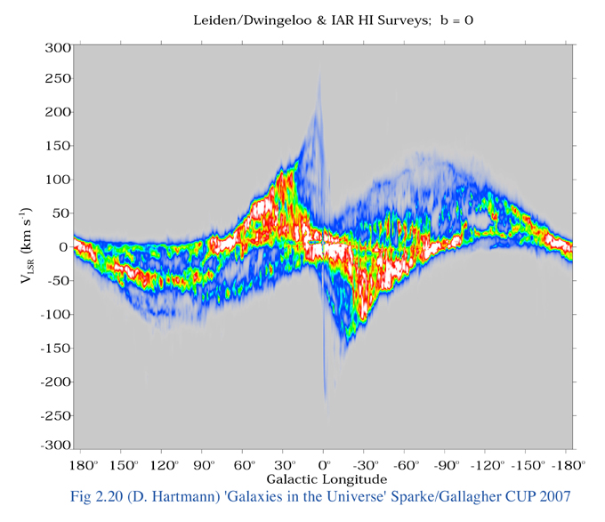
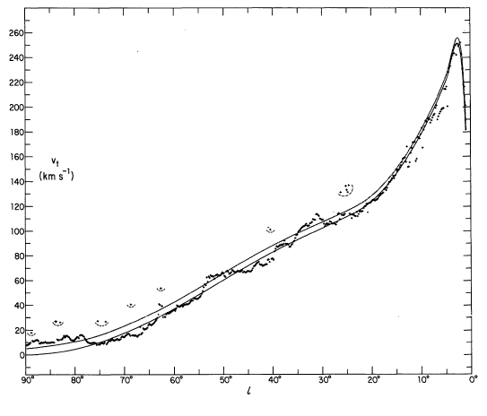
Inner rotation curve
Inner rotation curve can be well determined by measuring the terminal velocity
Sun
◎
V₀
l
R₀
R
φ
＋
V(R)
G.C.
Burton & Gordon (1978)

Slide 5
Outer rotation curve
Outer rotation curve can be determined only by measuring both distance and velocity of each object in the outer Galaxy.
Position (l, b, r)
V(R)
Astrometry is essential for this study
Velocity (V_{LSR}, μ_{l} , μ_{b})
Sofue et al. 2009

Slide 6
Recent progress 1
Gaia collaboration 2018: optical astrometry
Obtained a velocity field using 3.2 million giant stars
There are some reports that Gaia results are sometimes contradictory to VLBI results (Riess+2018,Groenewegen 2018, Nakagawa+2018 VERA UM)
Necessary to check the result independently with VLBI
Gaia collaboration 2018
Notes:
Additionally, Riess et al. (2018) and Groenewegen (2018) showed that Gaia parallaxes are systematically lower than accurate non-Gaia paral- laxes of Classical Cepheids by −

Slide 7
Recent progress 2
Reid et al. 2014: radio VLBI astrometry
Parallaxes for 103 objects were reported
50/103 are located in the Outer Galaxy

Slide 8
Recent progress 3
Mroz et al. 2018: Cepheid stars
+
+
+
+
+
773 classical Cepheid stars
distances are determined based on P-L relation
→necessary to check by VLBI

Slide 9
VERA Outer Rotation Curve Project
Member: H. Nakanishi¹,N. Sakai²,N. Koide¹,K. Kurahara¹, T. Kurayama³, T. Nagayama⁴ and many from VERA team (¹Kagoshima U., ²KASI, ³Teikyo U. , ⁴NAOJ)
Aim: to measure of annual parallax and proper motions for H₂O maser (22GHz) sources in the Outer Galaxy with VERA in order to obtain more
accurate Outer Rotation
Curve.
Progress from the former
work:
to increase the number of
sources based on the radio VLBI
Reid et al. 2014

Slide 10
our work

Slide 11
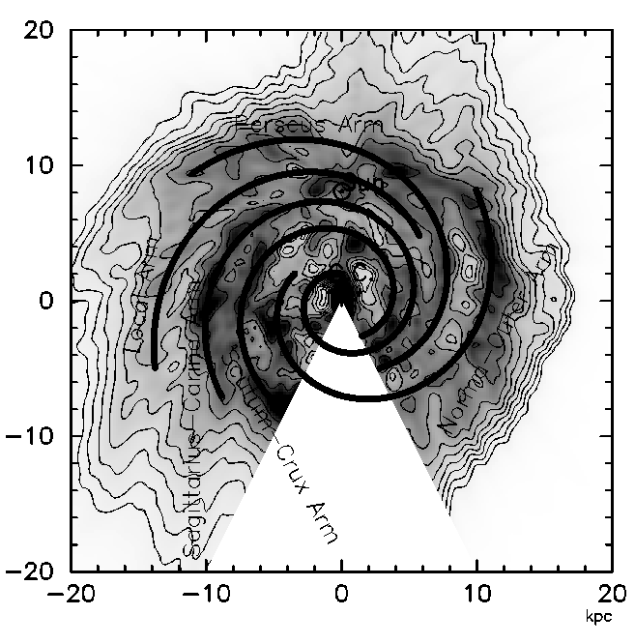
VERA ORC Targets
First ORC list
Selection criteria：
  Adopted from Brand+ 1994 （Arcetri catalog）,
  Sunada+ 2007
  Maser flux>5 Jy
  |V_{lsr}|>10km/s
  90°<l<240°, -10°<b<10°
  Calibrator found within 2.2°
  X band flux > 0.1Jy
  Not observed objects
→50 objects were selected
Nakanishi & Sofue 2016

Slide 12
VERA ORC Targets
Second ORC list
Selection criteria：
  Adopted from Wouterloot+1989, 1993
  kinematic distance > 5kpc
  90°<l<240°, -10°<b<10° Dec>-25°
  A calibrator found in the range of 0.3°- 2.2°from targets
  A calibrator was detected in K-band
  Not observed objects
→26 objects were added
Nakanishi & Sofue 2016

Slide 13
Results (preliminary)

Slide 14
Obtained Rotation Curve

Slide 15
Obtained Rotation Curve

Slide 16
Angular vel. & Epicyclic frequency
outer Galaxy
m=4 dominant?
inner Galaxy
m=2 dominant?

Slide 17
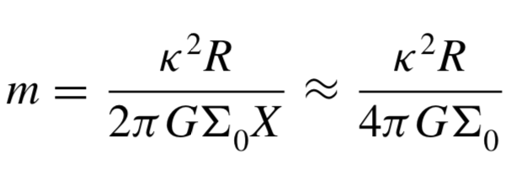
Expected number of spiral arms
Swing amplification theory (e.g., Fujii et al. 2011; Baba et al. 2013) suggests that the dominating number of spiral arms, m, is estimated as
m tends to increase in an exponential disk (Σ∝e^{-R/h})
NGC 1288 (Fuchs +1999).
N-body simulations
(Bottema 2003)

Slide 18
Summary
Outer rotation project has been carried out with VERA to measure more accurate outer rotation velocity.
35 objects have been observed and annual parallaxes and proper motions for 24 objects have been measured.
The outer rotation velocity was consistent with recent work (Reid+2014&Mroz+2018).
Epicyclic frequency seems to suggest that two and four spiral mode are dominant in the inner and outer Galaxy, respectively.

